Slide 1
Engage citizens with mail for local government
February 2020
YOUR LOGO GOES HERE

Slide 2
Having to deliver more for less
Local services face a £7.8 billion funding gap by 2025
Notes:
We almost certainly don’t need to tell you that Local Authorities are undergoing the toughest time ever. Having to do more and more for less money.
Councils provide more than 800 individual services.
And between 2010 and 2020 councils will have lost 60p out of every £1 of funding the Government provided for local services.
The pressure continues – the last 6 years has seen a 44% increase in the number of homeless households.
Ddespite fewer elderly people receiving support, spending by local councils on adult social care rose to £18.7billion, up 4.5 per cent on the year before. Spending on long-term care increased the most, by 4.8 per cent (This is Money, October 2019)

Slide 3
Engaging public effectively is critical
Public support is critical and impacts how councils deliver services to the local community:
58%
49%
38%
Are concerned about how budget reductions will affect the community
Are concerned about the impact the reductions is going to have on them
Say they do not think the council is getting more efficient
Source: APSE, Association for Public Service Excellence, 2017
Notes:
And local people are concerned that their communities are going to be affected, they are concerned that these pressures will affect them and the council’s efficiency.
Trust is a key element in ensuring citizens engage with what Local Authorities are doing and what they want their constituents to do.
Local Authorities have spent years outsourcing but are now bringing back their services in house. Around a third of Conservative Local Authorise and 42% of Labour Councils took back in house services in 2017 to take back control and focus on efficiencies.

Slide 4
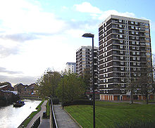
Mail can reach everyone
And there are still audiences local councils have to reach
10% of the UK are still internet non-users, not used in the last 3 months or ever
Not used the internet at home
Age 65+
Index 269
Not used the internet at home
Social grade E
Index 244
Not used the internet at home
Those receiving housing benefit
Index 149
Source: TGI, Q1 2020, ONS 2019
Notes:
Whilst internet usage has grown there are still audiences who are harder to reach online.
Those over the age of 65 index at 269 who have not used the internet at home in the last 3 months or ever. An index of 100 or more is significant, so 269 is high.
The same is true of social grade E and of those on Housing Benefit.
So whilst digital is cheap it doesn’t necessarily reach all the right people.

Slide 5
Not forgetting door drops
98%
Consumers receive and see door drops
Notes:
Door drop is one of the few media channels with almost 100% coverage of the UK – compare that to radio channels, outdoor and banner ads, for example.
Almost 100% penetration of UK households puts door drop in an enviable media position.

Slide 6
Addressed mail has the highest recall
81% recall seeing some form of communication from their LA in the last 12 months
What people recall receiving from their Local Authority – unprompted awareness
Source: Royal Mail Local Government Research, Illuminas, 2017
Notes:
And according to research by Illuminas on behalf of Royal Mail the highest recall of all communications received by Local Authorities are overwhelmingly “post addressed to me”, followed by door drop by a pretty large margin.
With local newspapers and emails trailing at 11% and 9% respectively.

Slide 7
mail is preferred by all age groups
For Local government communications
Mail
Email
Social media
Text message
16-29
year olds
65+
year olds
Source: Local Government Research 2017 Royal Mail MarketReach, Illuminas
Notes:
And despite the popular myth that young people don’t engage in any other channel than digital it is clear from this research that they do. Preferring mail for Council Tax, Local Elections and updates at much higher rates than email, social media or text message.
Whilst those over 65 engage with mail and door drop at higher rates across all types of Local Authority messaging.

Slide 8
the longer mail is kept the bigger the impact
How long have you kept it for
Up to 2
days
A few days
to 2 weeks
3 weeks to
2 weeks
3 months
or more
% agree strongly or slightly
It made me feel more valued
by the Local Authority
27
21
24
13
It made the Local Authority
seem friendlier
32
24
31
17
It made the Local Authority
seem more approachable
31
26
34
19
31
29
37
It made me feel more positively
towards the Local Authority
16
Source: Royal Mail Local Government Research, Illuminas 2017. Base: all received mail comms for topics other than Council Tax: Up to 2 days (210; A few days to 2 weeks (240); 3 weeks to 2 months (253); 3 months or more (340).
Notes:
Mail from Local Authorities stays around the home for a long time and the longer it stays the more likely it is to have a positive impact on the recipient. It makes the Local authority seem friendlier and more approachable.
And if it stays around for 3 months or more 37% agreed it made them feel more positively towards the Local Authority which is vital when you want to engage citizens.

Slide 9
Mail helps overcome barriers
MAIL IS MORE LIKELY TO BE READ IN FULL EVEN IF READERS’ VIEWS ARE NOT REFLECTED
Extent to which communication has been read / consumed which somewhat / strongly differed from my views.
Source: Communications in Electoral Engagement, Royal Mail MarketReach, Illuminas 2017
Base: All answers on communications which somewhat / strongly differed from views by media (excluding leaflets & magazines)
Notes:
When Royal Mail researched mail in the 2017 General Election Illuminas found that even if there are messages people don’t agree with they are more likely to read mail and door drop in full, above any other channel.
Mail is the best channel for getting someone’s attention, whatever the message: from when to put your bins out, from renewing a parking permit or paying a fine.

Slide 10
Gold standard data
Shows government mail out-performs other mailers
99% of Government / Council mail is engaged with
Versus 96% for all other mail
Source: MICMAIL, Q2 2017-Q1 2019 Addressed advertising/Business Mail. Bases: All Mail 72,595, Government/Council Mail 5,032
Notes:
JICMAIL, the Joint Industry Committee for mail captures what consumers do with their mail. JICMAIL has been created to provide standard industry metrics that all the other major media channels provide, like BARB for TV or Rajar for radio.
Government mail is engaged with at very high levels, higher than all other sectors captured in the data. And by engaged with we mean it has been opened, read, sorted or put aside for later, for example. When it is minimally processed it is thrown away only.
Reach shows that mail doesn’t just get to one person in the household either. We see from this data that for every 100 mail packs sent by Government or Local Council another 16 people will see Addressed mail or Business mail.
Addressed mail from Government is read by more people than average and is revisited 4.8 times versus 4.2, which is the average for all mail. Business Mail from Government/Local Council gets even higher levels of engagement with people revisiting that mail nearly 6 times. This mail will include items such as a Council Tax Bill or Parking Permit.

Slide 11
Physical engagement high
At higher levels than all other mail
Source: MICMAIL, Q2 2017-Q1 2019 Addressed advertising/Business Mail. Bases: All Mail 72,595, Government/Council Mail 5,032
Notes:
Government and Local Council mail is opened and read at higher rates than other sectors. It is much more likely to be filed and kept in the household and a lot less likely to be recycled.
Explanation note:
Not all mail needs to be opened, hence the open rate does not match the engagement rate of 99% on the previous slide.

Slide 12
Social actions high
All mail drives 32% of people to act – government mail drives 46% of people to act
Actions per thousand mail packs
Source: MICMAIL, Q2 2017-Q1 2019 Addressed advertising/Business Mail. Bases: All Mail 72,595, Government/Council Mail 5,032
Notes:
JICMAIL not only captures physical actions with mail i.e. what someone does when they have the mail pack in their hand or in front of them. What it also tracks is what other actions are taken with each piece, regardless of whether you are with the actual mailing pack.
A significant proportion of people (46%) getting Government mail will go on to take further commercial or digital behaviours.
Local Government mail prompts 250 people in every thousand to talk to someone else about the contents of that mailing piece. 137 people in every thousand contact the council (which you may or may not want to be happening as this may be increasing your cost to serve your citizens).
Mail is also driving significant online behaviour i.e. they are going to the sender’s web site or going online for more information more generally.

Slide 13
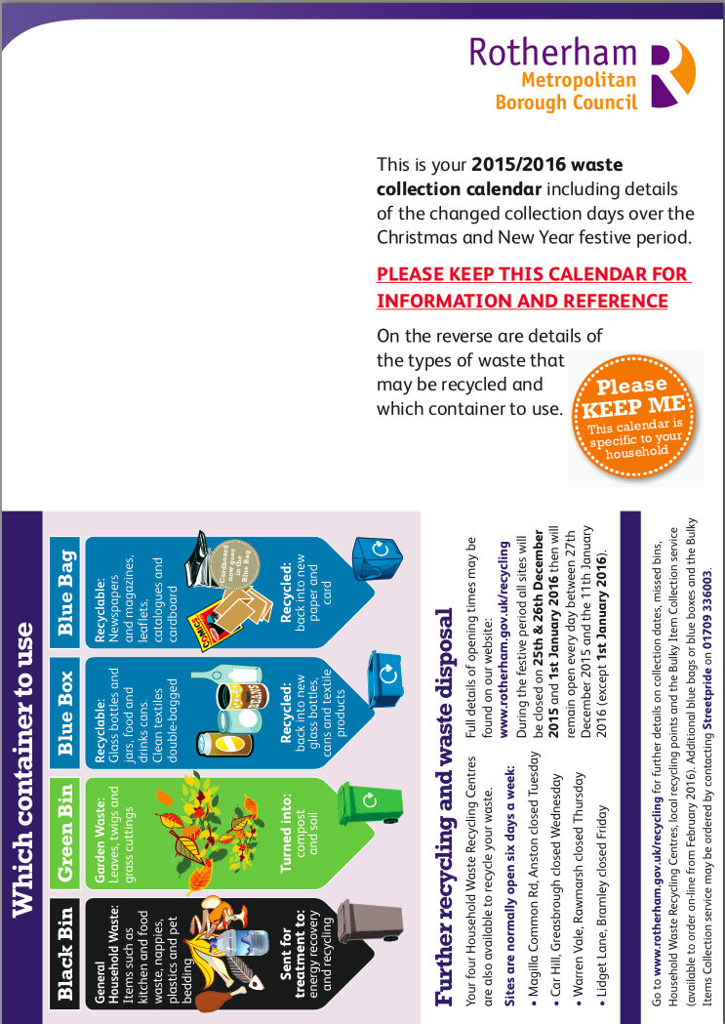
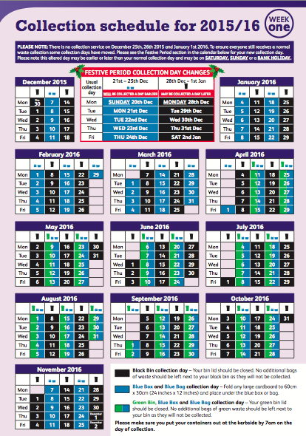
Getting information out
Accurately and with impact
PROBLEM
Rotherham Metropolitan Borough Council send a calendar to 116,000 residents to remind them of their rubbish day and what to recycle in which bin.
Hand delivery had been the cheapest option but it led to a large number of complaints from roads that were missed or had been delivered the wrong calendar with the wrong collection day. This resulted in increased calls into the Council, extra postage to supply the right calendar and bin crews having to make extra collections.
SOLUTION
In 2015 Rotherham switched from hand delivery to mail delivery. This tackled three core issues:
The right calendar was sent to the right residents, first time.
The impact meant that a personally addressed envelope got more attention.
And, as they were changing the service, it needed to land precisely before Christmas to inform residents of the changes.
RESULTS
The number of complaints dropped – saving time and money. The number of returns fell to 1% too, proving that mail was the most reliable way to deliver the calendar.
Case Study Courtesy of: Paul Hutchinson, Waste Officer, Rotherham Metropolitan Borough Council
Notes:
Background
Waste collection is one of the services provided by the Rotherham Metropolitan Borough that touches every household.
With fortnightly collection cycles and stringent recycling rules, it is important that residents know in which week of the two weekly bin-collection cycle each of their residual bins will be collected and which container to use for their recycling.
Rotherham Metropolitan Borough Council sends an annual waste collection calendar to all households in the borough to advise residents them on which week, in the year ahead, their bins will be collected. The calendar also informs residents what to recycle (and in which container) and of their Christmas collection amendments.
Two versions are printed – one for each week of the fortnightly cycle – and delivered to 116,000 households at the end of November before the Christmas collection amendments start.
To be cost efficient, the calendar had been hand delivered in previous years by a third party. However with increasing numbers of residents – many in the same street - ringing up to complain that they hadn’t received the calendar, or receiving the wrong calendar causing bins to being put out on the wrong week, it was clear that there was an increasing issue with accuracy of delivery.
Calendars not being delivered meant more staff were required to manage complaints and the Council was hit with unplanned costs of posting copy calendars. Even more impactful, was delivery of the wrong calendar – resulting in whole streets having to be re-mailed and bin crews making extra, un-scheduled visits to make collections until the problem was rectified.
Solution
After an extensive service review and cost benefit exercise, Rotherham Metropolitan Borough Council took the decision to switch from hand delivery to mail for the 2015/16 calendar.
Although hand delivery was cheaper, it was anticipated that mail’s other benefits would outweigh the cost savings:
1) Accuracy – with the resident’s address on the envelope, Rotherham were confident that they Royal Mail could guarantee delivery and, ensure that all eligible residents would receive their calendar.
2) Timing – in order for the Christmas service changes to be front of mind the calendar has to be delivered in the last two weeks of November. Hand delivery took a month to complete, meaning that some households received their calendars at the beginning of November – nearly 6 weeks before the Christmas service. With mail, the postal turnaround was completed in two weeks and fitted neatly in the November window.
3) Impact. An unaddressed envelope can be perceived as junk mail and thrown in the bin before opening. Addressing every calendar to each individual property, with wording on the envelope advising them that waste calendar was enclosed, gave Rotherham the confidence that the envelope would be opened and read.
The tangibility of the printed calendar also helped with compliance. The calendar was designed to be kept, hung up in the kitchen and referred to, providing a weekly breakdown of which bin to put out and simple pictorial references of what to recycle. Although this information was held online, not everyone was aware of this, or could access it.
Results
The change had an immediate positive effect, helping to affirm that mail seemed to be the most reliable way to ensure residents of Rotherham were informed about their bins service.
The number of complaints from residents claiming they hadn’t received their calendar dropped dramatically after the switch to mail – this reduced the workload and pressure on resources that usually occurs in November; saving time in managing, monitoring and rectifying the issues previously experienced with the hand delivery service and saving money by eliminating the need to remail or make extra pick ups.
It was also highly efficient, with post returns tracking at less than 1% - all with legitimate reasons such as property being boarded up, no access or automatic re-direction – meaning Rotherham Metropolitan Borough Council could confidently tell every resident who called up with a query or to complain that their calendar had been posted through their letterbox.
“By mailing the calendar with Royal Mail we can be confident that the calendar reaches every household and is opened, read and referred to.”
Paul Hutchinson, Waste Officer, Rotherham Metropolitan Borough Council

Slide 14
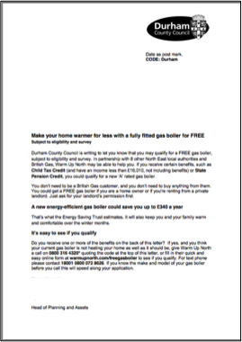
MAIL MAKES HOMES WARMER
BACKGROUND​
Every winter, the Housing Regeneration Team at Durham informs residents within the county what help is available to them via the Warm Homes Campaign. It is critical to reach those who are struggling to stay warm and pay their energy bills – especially during the cold winter months. ​
SOLUTION​
Mail was identified as the main mechanism for informing eligible residents based on key strengths.​
Mail is the most cost-effective way of reaching a very targeted group of individuals​
It is addressed personally to the individual resident, making it more likely to be opened & acted on​
Mail feels official – partner organisations help Durham fund the scheme but feedback from residents is that the scheme feels genuine and trustworthy when the message comes from Durham County Council.
RESULTS​
Across the rolling programme a 3% response rate is deemed a success – results for this campaign smashed this with a 5.2% response rate. ​
Source: Cliff Duff, Durham County Council, Housing Project Manager
Notes:
Background
Since 2010, Durham County Council have been running their Warm Homes Campaign to promote a range of government backed schemes that helps low income households – both home owners and private tenants – to carry out energy saving improvements such as installing a new central heating boiler or wall or loft insulation.
Every winter, the Housing Regeneration Team at Durham sets out to inform those residents within the county who are struggling to stay warm and pay their energy bills – especially during the cold winter months – what help is available to them via the Warm Homes Campaign.
Solution
Mail is the main mechanism for informing eligible residents within Durham County Council how they can transform their home with energy saving improvements.
With help from funding from partner organisations, the council mails a targeted group of residents during the winter months (pre and post Christmas), informing them of the schemes available to them and how they can apply.
Working closely with a number departments within the council, the Housing Team pull together all the information that is held on households in their county to identify which, out of the 260,000 homes, are eligible for help. These households are then mailed a single page letter in envelope that has the Durham County Council logo stamped on it.
There are three reasons why Durham believes that mail has become integral to the scheme’s success:
Mail is the most cost-effective way of reaching a very targeted group of individuals. And, as the mailing is produced in house, costs are further kept to a minimum.
The letter is addressed personally to the individual resident, making it more likely to be opened and acted on.
The envelope is clearly branded with Durham County Council’s logo, it’s on letter headed paper and signed off by a senior director within the council – all of which make the scheme feel official. Even though partner organisations help by funding the scheme, feedback from residents is that the scheme feels genuine and trustworthy when the message comes from Durham County Council.
Their latest mailing (October 2016), Durham County Council mailed 32,000 residents – their largest mailing to date - informing them of how they could ‘Make their home warmer for less’. In a single page the letter clearly spelt out the criteria for eligibility, communicated the savings that could be made and finished with a clear call to action.
Results
Mail is helping give the residents of Durham a warm glow.
Across the rolling programme a 3% response rate is deemed a success – results for the 2016 mailing smashed this with a 5.2% response rate.
“We had an excellent response to our mail out with a response rate of 5.2%, so there will be many households in County Durham that will have a warmer home after we have assisted them.” Cliff Duff, Durham County Council, Housing Project Manager

Slide 15
YOUR LOGO GOES HERE

