Slide 1
MAILMARK CATALOGUE SERVICE
May 2024

Slide 2
Mailmark catalogue product specification
A Mailmark variant of the Advertising Mail Catalogue Service will be introduced from 1st July 2024
Pricing
Format
Weights
Large Letter
The price structure will help to mitigate July ‘24 tariff increases
The service will be VAT rated at the standard rate
Letter and Large Letter formats will be available
The Catalogue service will have 10g price steps between 101-150g for Manual Letter and Large Letter formats
Maximum Mailmark Letter weight cap continues to be 100g
Maximum Manual Letter weight cap will be 150g, but has 10g price steps between 101g and 150g
Large Letter format has 10g price steps between 101-150g
Two price steps between 151g-250g and 251g-750g weight bands

Slide 3
mailmark catalogue service benefits
Ideally suited to the retail sector
Priced slightly below ad mail price
10g price steps to support customers to generate greater returns from their Catalogue mailings
Gives scope to increase pagination
Option to sell additional inserts with small price increments
Improving paper quality

Slide 4
Mailmark Catalogue service eligibility
Your mailing could be eligible if:
Examples of Eligible Mailings
The mailing primarily comprises a list of goods and/or services, together with a description, image and price;
The goods and/or services are sold directly from the page at the prices listed; and
The editorial and other content of the mailing is minimal.
A mail order company sending its new or seasonal catalogue to a prospective customer base
A travel company sending its new or seasonal holiday brochure to an existing or prospective customer base.
A mail order company sending its new or seasonal catalogue to an existing customer base.

Slide 5
catalogue pricing
From 1st July 2024
The service will be VAT rated at the standard rate
Prices shown in pence (p)
 | 0-100g | 101-110g | 111-120g | 121-130g | 131-140g | 141-150g | 151-250g | 251-750g
Access Advertising Mail Mailmark™ Economy Letter | 21.061
NEW PRODUCT Access Advertising Mail 70 Catalogue Mailmark™ Economy Letter | 20.684
NEW PRODUCT Access Advertising Mail 70 Catalogue Mailmark™ Letter | 24.253
Access Advertising Mail 70 Catalogue Letter | 30.418 | 32.150 | 33.881 | 35.612 | 37.343 | 39.074
Access Advertising Mail 70 Catalogue Large Letter | 37.218 | 39.596 | 41.974 | 44.352 | 46.730 | 49.108 | 51.223 | Base price 36.883 | 1g incremental price over 251g 0.0956
NEW PRODUCT Access Advertising Mail 70 Catalogue Mailmark™ Large Letter | 30.784 | 32.752 | 34.720 | 36.688 | 38.655 | 40.623 | 43.233 | Base price 32.073 | 1g incremental price over 251g 0.0744

Slide 6
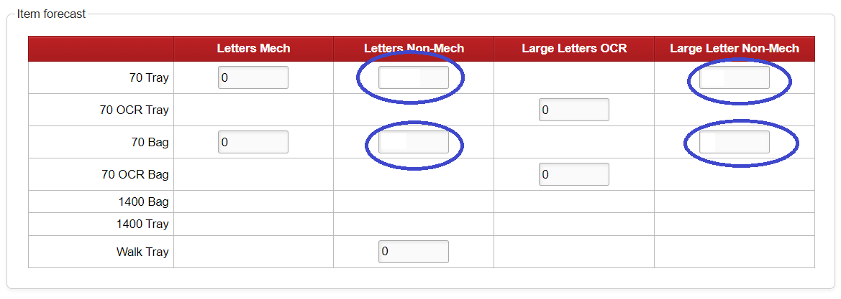
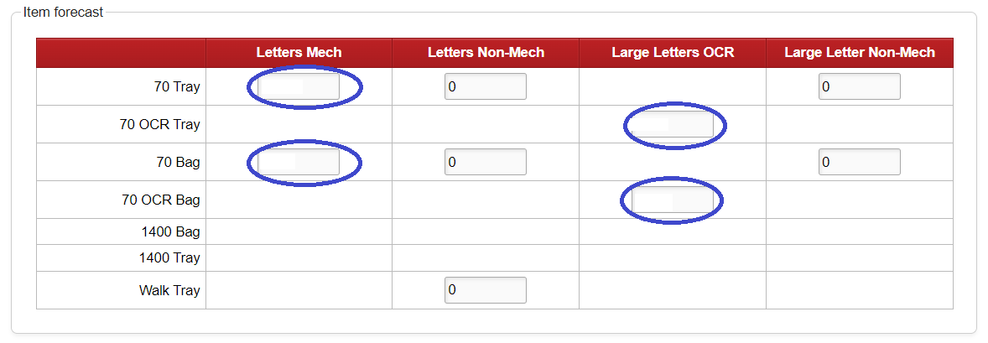
Dockethub traffic forecast
Illustration for Manual Catalogue forecasting
450000
300000
10000
18000
Illustration for mech forecasting
Use OCR for LL
The new 70 Catalogue products forecast will show under the existing appropriate selections on the traffic forecast screen for standard Letters and Large Letters contract.
250000
500000
10000
10000

Slide 7
Mailmark catalogue pricing
New Catalogue service codes:
DMA | 70__LETTER CATALOG EIB TRAY N
ZNN | 70__LETTER CATALOG EIB TRAY Z
DMC | 70__LETTER CATALOG EIB BAG N
ZNO | 70__LETTER CATALOG EIB BAG Z
DME | 70__LETTER CATALOG ECON EIB TRAY N
ZNP | 70__LETTER CATALOG ECON EIB TRAY Z
DMG | 70__LETTER CATALOG ECON EIB BAG N
ZNQ | 70__LETTER CATALOG ECON EIB BAG Z
DMI | 70__ LRG LTR CATALOG EIB TRAY N
ZNR | 70__ LRG LTR CATALOG EIB TRAY Z
DMK | 70__ LRG LTR CATALOG EIB BAG N
ZNS | 70__ LRG LTR CATALOG EIB BAG Z
Existing codes now become VAT rated:
DAJ | 70__ LETTERS CATALOG MAN BAGS N
DAK | 70__ LETTERS CATALOG MAN TRAY N
DAP | 70__ LRG LTR CATALOG MAN BAGS N
DAQ | 70__ LRG LTR CATALOG MAN TRAY N
ZBI | 70__ LETTERS CATALOG MAN BAGS Z
ZBJ | 70__ LETTERS CATALOG MAN TRAY Z
ZBO | 70__ LRG LTR CATALOG MAN BAGS Z
ZBP | 70__ LRG LTR CATALOG MAN TRAY Z

Slide 8
Emanifest and barcode selection
 | Class | Format (eMHS & 4STATE Barcode) | ResponseMailType (eMHS) Service Type (2D Barcode) | Mail Type (eHMS only)
Economy Mailmark Catalogue Letter (eMHS) | E – Economy | 1 – Letter | 0 - Mailmark Letter | 1 - Advertising
Economy Mailmark Catalogue Letter (2D and 4-state)
Standard Mailmark Catalogue Letter (eHMS) | 9 – Standard |  |  | 1 - Advertising
Standard Mailmark Catalogue Letter (2D and 4-state)
Standard Mailmark Catalogue Large Letter (eHMS) |  | 2 – Large Letter | 1- Mailmark Large Letter | 1 - Advertising
Standard Mailmark Catalogue Large Letter (2D and 4-state)

Slide 9
Catalogue content guidelines
Eligible for Catalogue Mail?
Example of Mailing
Explanation
A mail order company sending its new or seasonal catalogue to an existing customer base.
List of goods or services and direct sell from the page.
A mail order company sending its new or seasonal catalogue to a prospective customer base
List of goods or services and direct sell from the page.
A mail order company sending a postcard with a discount code to a customer who has already received a catalogue.
Not a list of goods or services.
A travel company sending its new or seasonal holiday brochure to an existing or prospective customer base.
Provided the brochure is primarily a list of holidays and options with prices clearly displayed.
A tourist office promoting a holiday destination by mailing a brochure to an existing or prospective customer base.
The brochure is promoting a country or a region. It is not primarily a list of good and services.
A brochure in support of a new car launch
Not a list of goods or services; the prices are illustrative ranges. Does not sell directly from the page but pushes to dealerships.

Slide 10
FURTHER INFORMATION
For more information contact your Royal Mail Wholesale Account Director

