Slide 1
Sales toolkit
Sector propositions
And incentives
February 2018

Slide 2
How to use this deck
Welcome to your simple tool kit to support you to create your own customer propositions. Use the information to best support your pitches.
The deck has four sections:
Sector Statistics – research to address potential communication challenges customers may be facing
Incentives over view – A summary of the RMG incentives with some ideas about what customers could do differently with mail
Potential test scenarios – Case studies to help you create compelling propositions that promote the value of mail
Benefits of Mail – A summary of recent insight and research to demonstrate the value of mail
CREATE YOUR TAILORED CUSTOMER PROPOSITION
1
Simply select the slides you want from each section
Add your own details
Take it to your customer
2
3
We would love to know how you get on using this information, so please feedback your experience to mike.griffin@royalmail.com

Slide 3
CONTENT
SECTON HEADING
SLIDE NUMBER
Sector Statistics and challenges
4 - 28
Incentives Overview & Test Ideas
29 - 45
Trends & innovation
46 - 73
Benefits of Mail Research and Statistics
74 - 103

Slide 4
Section 1
Sector statistics
And challenges

Slide 5





Challenges for Publishers
1
Retention is key
‘Publishers want faster payback but shouldn’t penalize loyalty. Managing subscriptions and renewals is key for growth’
2
Growth/Cross and Upsell
‘Publishers should tap into the print subscribers they already have to grow premium product lines’
3
Decrease in Advertising revenue
‘Publishers face pressure as Advertising revenue from print is not easily replaced in the digital world’
4
Will digital ever ‘take off’?
‘70% of consumer magazine buyers have no digital contact at all with their magazine brands’
1
5
Rise of free media
‘Abundance of free media widens consumer choice’
‘
1. Wessenden Marketing - Reimagining the Magazine Subscription: Selling magazines in an Amazon world

Slide 6
MAIL CAN HELP GROW SUBSCRIBERS
Challenge
Mail solution
Email solution
Subscribers and Renewals
71%
Open a brochure from a company they have ordered from before
29%
open retention emails1
12 months for price of 10
69%
Open mail about a promotion or special offer
21%
open acquisition emails1
Promoting a new Title
54%
Open a brochure from a company not ordered from before
“I think that’s the thing with post… I personally think there’s some value in it because people actually look at it.”
Jack, mid-20s
Source: Royal Mail MarketReach, Ethnographic Quant, Trinity McQueen, 2014
Notes:
Email and mail together is the best way to acquire/renew customers. Every print renewal goes towards fulfilment, and should be encouraged.

Slide 7
CREATING SMARTER BILLS AND STATEMENTS
THE OFFER
The opportunity to cost effectively re-design your paper bills and statements, to further improve your ability to communicate with and inform your customers.
To further benefit by reducing your test mailing costs by up to 30%.
Mail is more suitable for important messages. Consumers take time to digest content when a decision matters.
Notes:
Programmatic – the art of using insight to drive digital media buys to the right consumer – has transformed digital marketing.
But winning customers online is still a challenge
98% of prospects show interest but don’t buy. Less than 1/5 open their emails and basket abandonment rates are high at 69%. All this helps contribute to brands losing £116bn each year from people switching.
Is there a new idea – that the marries insight from programmatic with the tangibility of mail – that could enhance results?

Slide 8


WHY YOU SHOULD CONSIDER THIS OFFER
Improved statement understanding
50% more people understood what was in their account with a paper statement than an electronic one¹
Much higher open rates than email
At least 65% of all addressed mail is opened². Open rates are higher for paper statements with more people responding to an ‘unhealthy’ statement than email
Preferred for sensitive information
People prefer mail for sensitive or confidential account information with 51% opting for post, 35% email, 12% phone and 1% SMS²
Business mail is a very effective channel for prompting a response: 17% of all addressed mail³ and door drops lead to a commercial action
Prompts a response
£
¹ London School of Economics study 2017
² Kantar TNS / MarketReach 2017
³ JICMAIL research Jan 2018
Sources:
Notes:
Introducing Programmatic Mail – the revolutionary way of communicating with customers.
The targeting and delivery of physical mail can now be linked directly to consumer behaviour within the digital sales funnel. Using permissioned, first-party data, we can now send individually targeted direct mail to non-converting web visitors – often the next day, but always within 48 hours.
That can turn interest (and disinterest) into action

Slide 9
Evidence:
Customers value paper bills & statements
76% of adults see bills and statements by mail as valuable or extremely valuable (Source: IPA TouchPoints 5, 2016)
43% of paper bills and statements are kept for over a year (Source: Life Stages of Mail Quantitative, Quadrangle, 2016)
44% of customers keep paper bills & statements, in case they are needed (Source: Life Stages of Mail Quantitative, Quadrangle, 2016)
Notes:
Programmatic – the art of using insight to drive digital media buys to the right consumer – has transformed digital marketing.
But winning customers online is still a challenge
98% of prospects show interest but don’t buy. Less than 1/5 open their emails and basket abandonment rates are high at 69%. All this helps contribute to brands losing £116bn each year from people switching.
Is there a new idea – that the marries insight from programmatic with the tangibility of mail – that could enhance results?

Slide 10
AND INTERACT WITH THEM NUMEROUS TIMES
Monday
Card Statement
Open
Read
Tuesday
Saturday
£ OFF
Browse
Discuss
Visit store
Buy using voucher
File away
Source: JIC MAIL/ Kantar/ TNS - 2017
Notes:
Customers interact more than once with a mail piece. The length of time a mail piece stays active and is use by a customer varies but JIC Mail research 2018, shows that over 28% of mail is still live and in use by a consumer after a 4 week period.

Slide 11
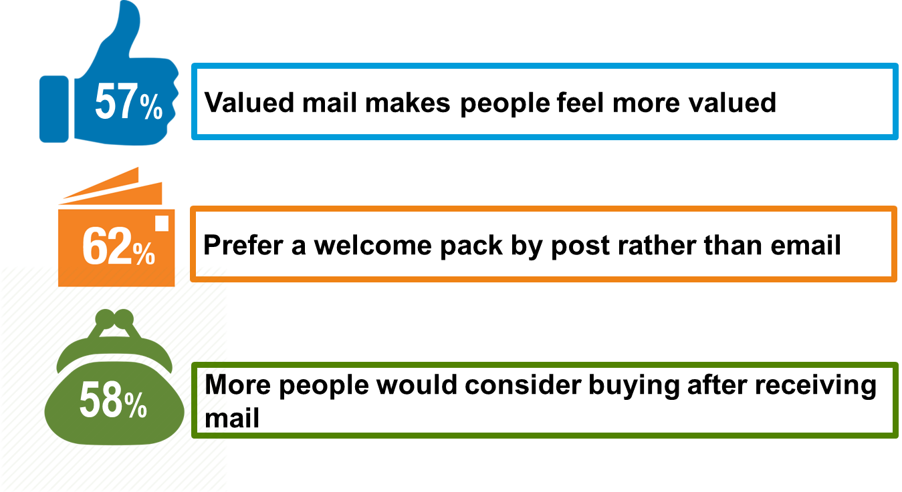
INSURANCE welcome
  3.4x
  Market share growth for service sector using mail
Switching is high across all insurance types
A 1/3 of customers switch within less than 12 months**
3 of 4 customers don’t trust their insurer**
Source: 1. Royal Mail MarketReach, IPA Databank Meta-Analysis, Peter Field, 2013
*Royal Mail MarketReach, Valued Mail, Quadrangle, 2014.
**Mintel, December, 2015 (average across commoditised Insurance products.). 2 DMA, 2015 . 3 Accenture.

Slide 12

Insurance renewals
1
Online
65-70% of consumers buy insurance online and shop around for lowest price at renewal
Majority using price comparisons
2
Switching
1/3 switch providers every year
Only 24% say they will renew with their existing insurer
3
Desired Features
Greater transparency around renewal/changes to premiums
Multi-channel preferred
4
Intermediaries
Use of intermediaries continues to decline
Less perceived value from consulting an expert
60%
of consumers said that
valued mail kept the
sender front of mind
57%
of valued mail recipients think more positively about the sender
‘

Slide 13
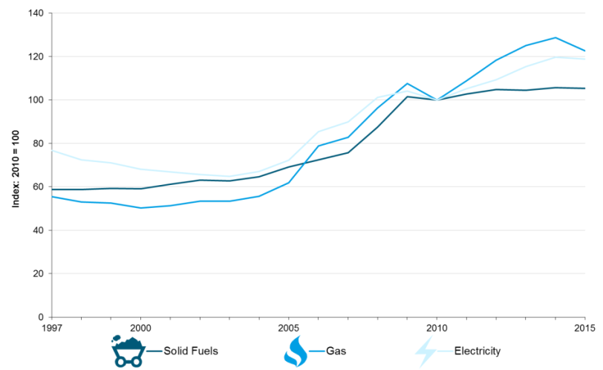
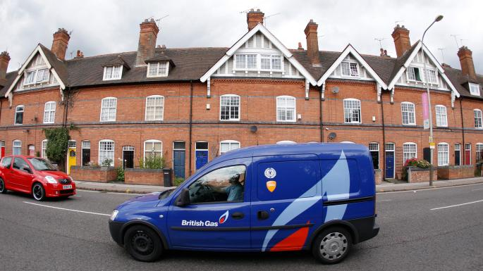
THE ENERGY MARKET ‘TRI-LEMMA’
Long-term challenges facing the UK’s domestic energy have been dubbed a ‘Tri-lemma’:
  De-carbonisation: drive to renewable energy
  Affordability: focus on smarter usage and lower costs
  Security of supply: by 2020 60% of the UK gas supply is set to be imported, rising to 90% in 2035
Key trends putting the squeeze on energy since 2000:
  12% rise in household numbers
  10% population growth
  Huge growth in number of products consuming energy
  Brexit effect on economy and confidence
In contrast:
  Recent, dramatic decline in consumer confidence and greater focus on household costs intensified with Brexit vote
  Drop in domestic energy consumption of 19% since 2000
  Average 20% increase in energy costs since 2010
  British Gas are latest to announce 12.5% rise in electricity, 7.3% in Dual Fuel, following other suppliers incl. SSE, Npower, E.On
  Cheapest fixed rate has risen by 12% to £833 pa since April
Despite smarter, reduced consumption and move to alternative energy, 2020 targets for reduced greenhouse gas emissions unlikely to be met, putting pressure on regulators and suppliers to do more. Mooted changes to tax laws include proposal to price carbon according to supply and demand.
CPI for gas & electricity
British Gas raises electricity price by 12.5%
Emily Gosden, Energy Editor
August 1 2017, 9:00am, The Times
Sources: ONS; PwC Energy market report; Dept of Business, Energy & Industrial Strategy 2016
CBI: Climate Change, everyone’s business 2016 ; Times 01.08.17; Telegraph 01.08.17
Notes:
Energy suppliers facing ‘pincer movement’ with pressures on:
Supply: move away from fossil fuels to more costly renewables
Demand: rising number of households and products consuming energy
Tariffs: less complexity, more transparency reduces profit options for suppliers

Slide 14
UTILITY SWITCHERS SUMMARY
5.912M adults have switched utilities in the past 12 months
80% of switchers always look out for special offers
11% are from Mosaic Group H Aspiring Homemakers
74% of adults who have switched utilities have responded to direct mail in the past year
14.8% of media spend in the utilities in 2016-17 was for direct mail.
They are 34% more likely than the average adult to be a heavy responder to mail
81% of utility switchers like receiving money off coupons
16% of utility switchers are from Cameo Group 7 Paying the Mortgage.
Source: TGI 2017 Q1, Nielsen, Mintel, Ebiquity

Slide 15
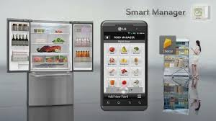

PLATFORMS FOR ENGAGEMENT: SPREAD
GOOD NEWS ON ENERGY
Multiple opportunities to stimulate dialogue positively, rebuild tarnished reputations:
  66% adults interested in fridge technology that runs automatically when energy is cheaper
  Green home technologies e.g. affordable homes constructed from sustainable wood or high-insulation hemp and lime
  More efficient white goods conserve water and electricity usage
  Smart-meters show energy costs/savings
  Ways consumers can generate their own energy
  Programmes to test/implement measures providing additional or alternative information on energy value/usage
  Review/change information provided on domestic bill
Prize for successful energy brand is to reposition as service provider:
  Facilitate take-up of smart devices to give ongoing read on consumption
  Automated data collection becomes basis for smarter usage patterns
  Energy provider takes over challenge of supplying power in most cost-effective way from householder
  Build on current promotional strategies, especially with provision of multiple services incl. broadband, mobile
  Consider reward strategies as competitors start to trial loyalty programmes
Unique challenges facing energy suppliers’ messaging – engaging customers in inherently uninteresting market and explaining complexities of ‘smarter’ usage – can be solved by mail/door-drops:
  Analysis of individual household energy usage/behaviours the pre-cursor to relevant, targeted messages
  Print medium allows clear explanation of complex technology and/or supply management
Sources: OFGEM; Energy Live News, Energy UK July 2016 ; ‘Lean & Green’ Mintel
Notes:
All this ‘noise’ and activity has culminated in greater levels of interest and engagement among consumers. People are now more likely to actively seek ways of cutting costs, saving energy, making their homes ‘smarter’.
The growing impact of digital technology has facilitated this. The pace of change in tech markets is such that availability and take-up of devices to monitor and control the use of in-home energy will become more and more mainstream.
There is clear opportunity for energy brands to take the lead here, by being more helpful and transparent; by offering information and suggestions on optimal ways of consuming energy and saving money; by facilitating/subsidising the use of new digital devices, targeted tariffs and payment plans etc.
For some energy suppliers, for opportunity read necessity: reputational damage to the Big 6 suppliers has to be addressed if market share declines are to be reversed. Communicating transparently and openly, with advice on smarter energy usage, would be an obvious strategy to fulfil this need.

Slide 16
CHANGED UTILITY SUPPLIER IN PAST
YEAR- RESPONSE TO DIRECT MAIL
Response to direct mail in the past year
74% of adults who switched utility supplier in last year have responded to advertising mail in the past year
Source:
Touchpoints 6 2015
Notes:
16

Slide 17
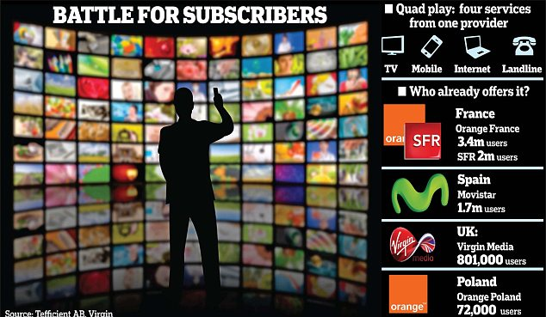
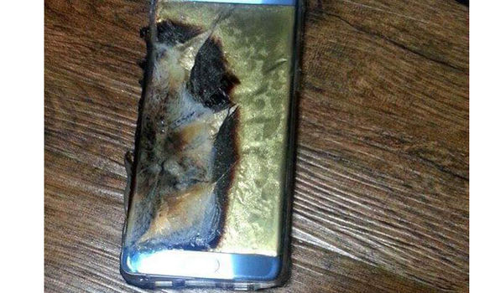
LIMITED DIFFERENTIATION IN TELCOS:
LOYALTY DRIVEN MORE BY INERTIA?
Brand loyalty relatively strong in telco markets:
51% loyal to mobile network provider
73% have not switched bundled provider in last 3 years
Future brand emphasis likely to shift from acquisition to retention
But inertia/market dynamics may be real drivers:
70% customers on 2 year mobile contract say they will upgrade with the same manufacturer
Only 29% smartphone users prioritise brand over price, with 25% in tablet market, 14% in TV, 12% in PC
High brand awareness levels across telco markets but limited differentiation:
2016 decline in adspend to £84m (Samsung: 38% SoV, Apple: 24% SoV, Google: 14% SoV) means brands relying on salience created to date
Samsung is most trusted, despite Note7 battery fires; Sony awareness high, but trust and differentiation low
Apple is most differentiated: positives include style, functionality, exclusivity, but seen as over-rated, costly
Source: Mintel ‘Mobile Network Providers’ 2016; ‘Bundled Communications’, ‘Mobiles UK’ 2017’
Notes:
Strong brand loyalty in mobile market partly driven by 2 year contract cycle, with cost of handset discounted over contract:
To date few signs of brands actively seeking to promote/incentivise loyalty
29% smartphone users would prioritise brand over price/product; equivalent ratings for other telco sectors: 25% tablet, 14% TV, 12% PC
Slower/longer handset upgrade cycles, more SIM-only deals and roll-out of eSIM: all have potential to disrupt current loyalty/inertia
Samsung most trusted, despite Note7 battery fires; Apple is most differentiated with positives of style, functionality, exclusivity but negatives that over-rated, expensive
Sony brand awareness/user base across telco markets high, but trust/differentiation lower
Currently lowest price is not key purchase criterion, but rising inflation and anticipated post-Brexit slowdown may re-focus consumers on headline prices. consumers more likely to ‘value’ tailored/personalised propositions reflecting behaviours/needs

Slide 18
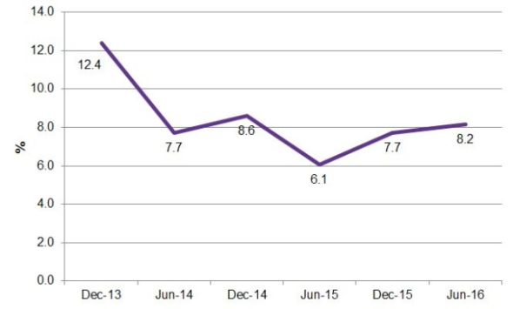
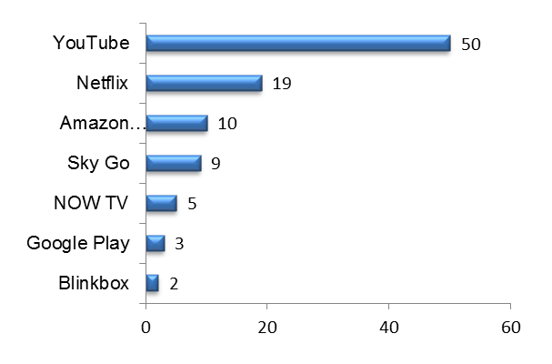
TELCO - SLOWING RATE OF INNOVATION,
GROWING DEMAND FOR PERSONALISATION
Telco markets are mature, intensely competitive, highly regulated:
2016 mobile revenues of £6.6bn, predicted to be static to 2021
Slowing pace of innovation: broadband showing fastest growth as use of multiple devices grows
5G roll-out in 2020 is next major innovation likely to shake up market: predicted 12 x increase in speed creating $12 trillion value across globe
Consumer ‘bargaining power’ is on the rise:
Rise of personalised viewing and content download suggests future innovation should be focused more on catering to individual needs
Brand choice/loyalty more likely driven by quality of service than by price or brand
Greater range of packages reflects consumer demand for more choice based on their needs:
Smartphones remain the fastest growing technology product: 82% penetration vs 93% for standard mobile, with record high 48% customers on 2 year contract
SIM-only deals (23% share currently), family packages (mobile and quad-play) and subsidised data are new propositions gaining traction
High demand for more data and fast broadband: 30% have superfast broadband connections
Growing incidence of bundling/partnerships to grow the quad play market e.g. Sky with O2, BT with EE
Voice control (Alexa, Siri, Bixby) now more important in brand choice
Streaming and downloading TV content:
“We think that 5G will have an impact far beyond [3G],” said Ben Timmons, Senior Director, Business Development of Qualcomm Europe. “It’s not going to be about personal communication anymore. It’s much more of a transformational technology that will have a huge impact on an enormous range of industries."
Proportion of consumers who have spent extra money on home electronics/home entertainment systems:
Source: Mintel ‘Mobile Network Providers’ 2016, Bundled Communications’, ‘Mobiles UK’ 2017; Ofcom Comms Report 2016, McKinsey reports
Notes:
2017: key telco markets relatively mature, highly regulated, with slowing pace of innovation and little if any revenue growth:
2016 mobile revenues of £6.6 billion predicted to be stable/decline slightly over next few years, with £7bn revs predicted in 2021
2020: 5G roll-out is next major innovation likely to shake up sector
Challenge to brands now is to improve current service(s) and/or offer more tailored, personalised packages
Flat revenues and intensifying competition among providers giving consumers more bargaining power:
Record peak 48% mobile customers on 2 year contracts but likely to decline
SIM-only deals (currently 23% share), family packages (mobile only and quad-play), subsidised data are among small but growing propositions gaining traction among consumers

Slide 19
TELCO - PERSONALISED PACKAGES:
A MAJOR BRAND OPPORTUNITY
Customers moving beyond ‘innovation for the sake of it’ to ‘packages best meeting my needs’:
Brand partnerships can improve relevance/quality of content provision, facilitate multi-channel access: Sky/O2 and EE/Spotify good examples
‘Smart’ devices offer consumers an easy, cost-effective way of accessing content and managing costs
Collecting/analysing data critical to satisfying desire for ‘personalisation’, eSIM the catalyst for this:
Data capture and analysis from multiple devices allows targeting of personalised TV and different bundles to customer segments, based on real habit/preference
Focus on building relationships: deliver strong service to support value proposition:
Consider more targeted communications to engage by life stage e.g. younger segments (16-34 year olds) less satisfied with their current provider are more likely to research competitor deals
Offer lapsed customers flexible bundles which don’t tie them in (e.g. Now TV) but do re-engage with brand
Develop relationships by tailoring and refining individual ‘packages’ over time, and reminding people of the value of long-term brand loyalty
Role of mail/door-drops highly distinctive in increasingly digital world:
Communicating complex/detailed product information demands a proven medium to explain and build trust
Can surprise and delight, convey exclusivity, be personalised, acknowledge and reward loyalty
GDPR awareness and implications:
Clearly communicate the positive impact and benefit to customers
Direct mail and door drop help engage and target new customers without requiring specific data opt-ins
Notes:
Tightening margins in highly competitive, maturing market has given consumers greater bargaining power, seen slow transfer of costs from users to service suppliers:
- quad-play packages, bundled offers (Spotify & Netflix), focus on value of data (sponsored data)

Slide 20
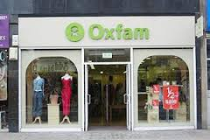
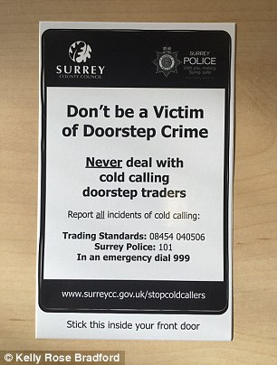
CHARITY MOUNTING PRESSURE ON
REVENUE CHANNELS
MPs increasingly critical of charities:
  63% believe charities too political
  Government review into all aspects of charity management coincides with calls for new, independent charity watchdog
BREXIT and economic slowdown likely to put a brake on donations and funding:
  Decline in donating to overseas charities as greater proportion goes to domestic causes
  Ad hoc donations growing, but donations by direct debit static
  Experts predict declining revenues as households face squeeze
  Uncertainty about revenue streams as many UK Charities benefit from EU funding
Charity shop profitability poor compared with US and UK retail sector:
  UK charity shop profits average 17% vs 83% in US, 18% for Next
Growing resistance to phone, door-to-door and street collections:
  Public Fundraising Association levied £165K in fines from sector
  3300 on-street offences reported
  Charity Commission issued a formal warning to 1700 charities to review fundraising methods
Sources: nfpSynergy 2017 Charity Monitor; House of Commons ‘Charities & the voluntary sector, 2016’; Civil Society

Slide 21
FPS & GDPR WILL IMPACT CHARITY SECTOR
Fundraising Preference Service (FPS) launch in July 2017, combined with new General Data Protection Regulation (GDPR) laws in May 2018, will significantly effect fundraising strategies:
  Both initiatives strongly supported by general public
FPS allows public to ‘opt out’ of any/all comms from charities:
  Puts pressure on charities to maintain accurate databases, & rules out inter charity data share
  Suggests greater reliance on existing donor relationships
General Data Protection Regulation (GDPR):
  Wide-ranging security, protection and privacy laws aim to give consumers greater control of personal data
  Puts onus on businesses to record exactly how data is collected and processed, what permissions or consents exist
Rules around First vs Third Party data clarified:
  First-party marketing to existing customers/warm leads requires opt out message
  Third-party marketing to cold prospects requires them to have previously opted in, meaning data sourcing with correct proof of consent much harder
SIX STEPS
PREPARING FOR GDPR
Map data flows
Set up project team
Check data consents
Best Practice data
capture & consent
Test retention/acquisition
with Mail and Door Drop
Evaluate, iterate
Notes:
GDPR will herald major changes to the ways in which businesses hold and exploit personal data, particularly around opt-in and opt-out marcomms.
Royal Mail’s proprietary GDPR process offers clear steps to ensure energy suppliers are compliant in their data usage, and can best exploit insights derived from data analysis.
GDPR especially relevant to energy market, in promoting take-up of smart devices among households with a clear need (based on analysis of behaviours) – a potentially complex message to communicate, which demands time and concentration from customers to fully appreciate the benefits.

Slide 22


CHARITY OPPORTUNITIES FOR MARKETING
Key challenge is to strengthen relationships with existing donor base, as economic climate worsens and tighter regulations take effect, and continue to address consumer scepticism:
  Strong loyalty to ‘favourite’ charities shown by current donors, especially women and 55+ age group
  Preference for communication that builds an emotional connection (52% support) rather than relying on shock value (37% support)
  Demand for information and transparency: explain charity’s structure, role, cost base and achievements and “show me how my money is being used”
Evidence of recent trends suggests immediate messaging opportunities:
  ‘Big idea’ campaigns focused on specific day/week offer blueprint to build awareness
  Social media and local print (DM, door-drops) drive engagement, often through undertaking a challenge using friends and family networks
  Print is ideal medium to explain detail of big idea, with materials to share
Sources: Mintel; TFF Lifting the Lid

Slide 23

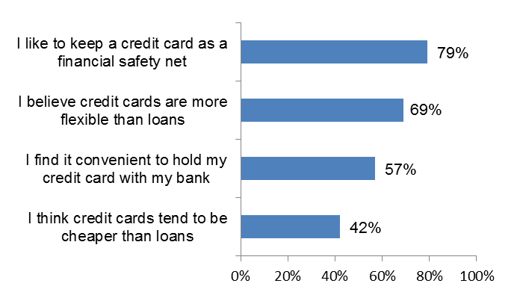
CREDIT CARDS USED FOR DEBT
AND CONVENIENCE
Most card-holders see main benefit as convenience:
  Helps to smooth financial ups and downs
  Cheaper and more flexible payment method than a loan
59% card-holders are ‘transactors’ who pay off balance monthly; 37% are ‘revolvers’ who pay minimum each month, using credit card as borrowing tool
Engagement in market is strong but ’rational’:
  34% researched new offers
  45% tied in with cashback/other reward for usage
Most preferred features are:
  0% interest on purchases (for defined period)
  Ability to collect points/rewards
  Low APR
Attitudes towards credit cards for those who have them
Sources: FCA 2016 Annual Report; Aviva Family Finance Report 2016

Slide 24
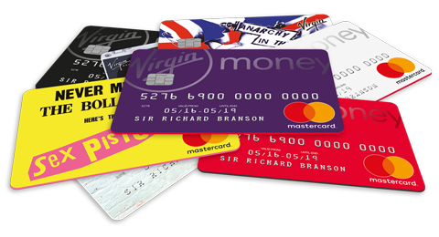

HIGH STREET BANKS PRE-EMINENT IN
UNDIFFERENTIATED MARKET
Limited differentiation between brands
High street banks capitalise on long-standing heritage and high street presence – Santander, Halifax and Nationwide are most recognised
Other brands i.e. Amex trade on a more emotive image of exclusivity while Virgin major on fun in order to achieve cut through
Transactional, offer-based promotions dominate marketing strategies:
  0% balance transfer most common form of promotion
  41 months is longest interest-free, transfer balance period
Jessica Emmis-Hill still features in Santander advertising, collateral and online
Virgin Money continue to offer bespoke card designs
Sources: Mintel 2017, UK Payments Market Summary 2016

Slide 25
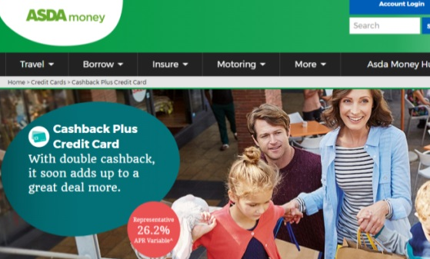
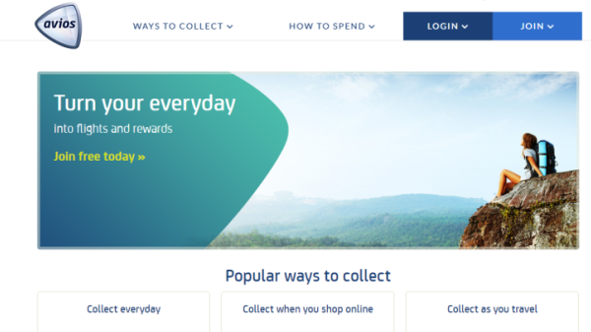
CHALLENGE FOR BRANDS IS TO ENGAGE
CUSTOMERS WITH TARGETED RETENTION
Signs that customers are rationalising the number of cards in their wallet
  41% have one credit card only
  30% prefer simplicity of fewer cards
Fewer cards puts onus on brands to recognise customers’ spending habits and tailor offers which could help differentiate brands more
Consumer switching due to affordable and available credit means that providers will need to think beyond the 0% and low rates to retain customers
Rewards, points or cashback on spending are popular retention strategies
GDPR data availability creates a challenge for brands as permission will determine whether you can build a relationship with that individual
Notes:
Higher income (£50K+) more likely to have 2+ cards

Slide 26
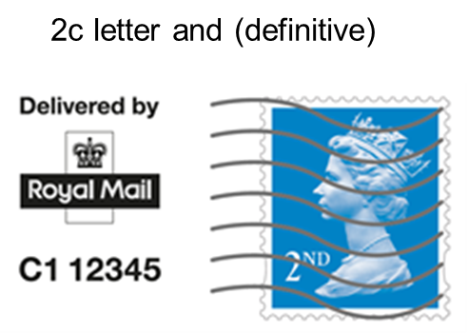
DEBT COLLECTION
Consumers are becoming less engaged with email
However 98% of adults have a postal address1
Mail can help to prompt changes in behaviour
The Testing incentive is designed to help you overcome the barriers to testing
Test a new use of mail and earn 30% discount
Test Ideas:
Creative test – a redesign of the layout of your mail can simplify the message and increase response rates
Digital Stamp – more personal form of indicia can increase opening rates
New contact letter – adding a new letter to your contact strategy can increase response rates
51%
of emails are deleted within two seconds²
Digital Stamp
1 Email Marketing Metrics Benchmark Study, IBM, 2015 2. Litmus Email Analytics, 2013

Slide 27
LOCAL AUTHORITY
Only 23% of the public agree that councils
are adopting digital to improve public services
Councils are under pressure to constantly deliver more services for less
Mail can be viewed as a costly channel and things are cheaper to deliver online
But not everyone can be reached online and the impact that mail has can out-perform digital channels
98% of consumers receive and see Door Drops*
Mail can work really hard to ensure people are getting the message you need them to understand – recycling, rent collection, council tax
And it works well with digital too, as part of an overall plan
We can work with you to get the most out of mail and door drop and deliver you the greatest value
38%
of residents say they don’t think their local councils are getting more efficient
Source: The Local State We’re In, PWC, 2016.
* Royal Mail, MarketReach, Doordrop Stats Refresh, Illuminas, 2014

Slide 28
BUSINESS MAIL SME
Business mail is valued by customers and delivers commercial value
If SMEs have proof that business mail works better than say email, they will choose it
The majority of SMEs would like to learn how to use business mail better
Insight, research and media tools to help you maximise your campaign are available at www.mailmen.com
76%
of adults see statements
by mail as valuable or
extremely valuable*
3.8 out of 5
customers confirm that bills
and statements from existing
suppliers are the highest
scoring pieces of mail*
“Mail that makes people feel
…makes them do something”
*Source: IPA TouchPoints 5, 2016
Notes:
The Business mail SME proposition is now live and ready to be rolled out to the relevant clients
Here is some key information about the messaging and proposition:
Customers feel valued when they receive mail that is relevant, makes them change their mind, or is taken to heart
We know that Mail that makes people feel, makes them do something.
Business mail is a valued form of customer communication. 76% of adults see statements by mail as valuable or extremely valuable and 3.8/5 customers confirm that bills and statements from existing suppliers are the highest scoring pieced of mail. Source: IPA TouchPoints 5, 2016
Not only is Business mail valued by customers, but it also delivers commercial value: in fact 92% of customers who felt something when they received mail, did something of commercial value (Base: 3000. Source: Royal Mail MarketReach, Valued Mail, Quadrangle, 2014
Those who acted on their mail, took more than one action: they also advocated, researched or planned an activity.
This creates a real business opportunity as the majority of SMEs would like to learn how to use business mail better, to generate action among their customer base
Our Marketreach Sales presenter explains the Business Mail SME value proposition in more detail, and is now available on the hub for you to use, please go to:
Media Specialist Resource Centre
Campaigns & Research
Business Mail - SME

Slide 29
Section 2
incentives
overview

Slide 30
Advertising mail growth incentive
15% off for new incremental Advertising Mail posted above a pre agreed “baseline” volume over a 12 month period
THE DEAL
  Discount rate of 2.5p (for machine readable letters) to 10.9p (for heavy Large Letters) off the Royal Mail price for all incremental mail posted above the agreed baseline
Discounts paid retrospectively in the form of postage credits
WHO’S ELIGIBLE
Anyone sending new, incremental advertising mail volume of at least 150,000 items over a defined 12 month period
For postings sent directly with Royal Mail or an Access Operator
KEY POINTS
Applicable to advertisers at overall legal entity, specific customer, brand or sub brand
The baseline volume will be determined by Royal Mail, based on customers’ historic advertising mail volumes

Slide 31
VOLUME COMMITMENT incentive
For customers who complete the Advertising Growth Incentive, a discount from the Royal Mail price for commitment to send the same volume of mail during the following year
THE DEAL
  Discount rates of:
  1.25p to 5.45p for matching last years advertising volume and
  2.5p to 10.9p for incremental advertising volume
Discounts paid retrospectively in the form of postage credits
WHO’S ELIGIBLE
Customers who have recently completed the Advertising Growth Incentive and can commit to sending at least the same amount or more advertising mail than they sent in the previous year
For postings sent directly with Royal Mail or an Access Operator
KEY POINTS
Applicable to advertisers at overall legal entity, specific customer, brand or sub brand
Matched volume commitment is measured over a 12 month period

Slide 32
TESTING AND innovation incentive
15% - 30% off for testing new uses of business mail or advertising mail
THE DEAL
30% discount on business mail tests and 15% discount on advertising mail tests carried out over a period of 1 – 6 months
10% discount in months 6 – 12 for business mail tests that roll out
Discounts paid retrospectively in the form of postage credits
WHO’S ELIGIBLE
Anyone testing a new mail activity, and sending a minimum of 10,000 items in a test (limited to 10m items for business mail and 1m items for advertising mail tests)
  For postings sent directly with Royal Mail or an Access Operator
TEST
IDEAS
New letter content
Re-design of letter layout
Envelope changes

Slide 33
First time user incentive
15% off for customers who have never used Advertising Mail or have not used Advertising Mail for some time
THE DEAL
  Discount rate of 2.5p (for machine readable letters) to 10.9p (for heavy Large Letters) off the price off the first three advertising mail campaigns
  Discounts paid retrospectively in the form of postage credits
WHO’S ELIGIBLE
Customers who have never used Advertising mail previously or who have not used Advertising mail for the last 24 month
Minimum volume is 10k items per advertising campaign
  For postings sent directly with Royal Mail or an Access Operator
KEY POINTS
Customers can earn postage credits for each of their first three First Time User advertising campaigns carried out over a 12 month period

Slide 34
Publishing Incentives
New Title
Tests
Publishing Volume Commitment
Acquire & Cross Sell Tests
Renewal
Tests
30%
Discount for Yr.1
10% roll out disc. Yr. 2
c2%
Discount on eligible retained volume
15%
Discount for up to 6 months
15%
Discount for up to 6 months
30% discount on new titles launches (inc. growth tests on existing publications) for Yr1 with 10% discount if rolled out into Yr2
Must send 10,000 items per year
Customer must intend to roll out beyond Yr.1
For postings sent directly with Royal Mail or an Access Operator
Discount paid as retrospective postage credit as credit vouchers or direct into account
Earn c2% on eligible mail when prior year volume is retained (min.500k).
Must retain at least 95% of all Publishing mail items sent in prior year
Discount will be earned on eligible items only – Large Letter below 750gs
For postings sent directly with Royal Mail or an Access Operator
Discount paid as retrospective postage credit as credit vouchers or direct into account
15% discount for tests that assess whether mail can improve subscription acquisition and cross-selling
Must send 10,000 items per test
For postings sent directly with Royal Mail or an Access Operator
Discount paid as retrospective postage credit as credit vouchers or direct into account
15% discount for tests that introduce the use mail for renewals or that add a new stage of mail to the renewal process
Must send 10,000 items per test
For postings sent directly with Royal Mail or an Access Operator
Discount paid as retrospective postage credit as credit vouchers or direct into account

Slide 35
Addressed mail Incentive Summary
FTU
First Time User
Open to customers who have not used advertising mail for 24 months
15% postage credit (2.5p – 10.9p) on Wholesale made after the 30 June 17
Discount applied to 3 mailings over 12 month period
Bus Mail TIS
Business Mail Testing & Innovation Scheme
For Business Mail tests of between 10k to 10m items
30% postage credit (6.9p – 24p) for tests lasting up to 6 months
10% postage credit on (2.3p – 8.0p) for a further 6 months when tests are rolled out
Ad Mail
TIS
Advertising Mail Testing & Innovation Scheme
For Advertising Mail tests of between 10k to 1m items
15% postage credit (2.5p – 10.9p) for tests lasting up to 6 months
Ad Mail Growth Incentive
Advertising Mail Growth Incentive
15% postage credit (2.5p – 10.9p) on incremental mail sent during a 12 month period
Minimum threshold of 150k incremental items
Ad Mail Volume Commit
Advertising Mail Volume Commitment Incentive
Over a 12 month period match the volume posted during the Advertising Mail Growth Incentive and earn 7.5% postage credit (1.25p-5.25p)
For incremental mail sent during this period earn 15% postage credit (2.5p-10.9p)
Notes:
As a reminder, here is a summary of the addressed incentives and the all-important Siebel codes!

Slide 36
TIS CASE STUDIES AND Test ideas

Slide 37

CASE STUDY:
The challenge:
Welcome packs received from CBPF (not the originating insurer / broker) created confusion, resulting in large volumes of inbound calls and 10% non returned / incorrect credit agreements.
The solution:
The welcome pack was redesigned to be less confusing. The Broker name plus a clear and simple Call To Action was added.
The result:
Annual savings of c£270k for a redesign investment of £10k.
Far fewer credit agreements are now completed incorrectly
Letter / processing costs for sending out new credit agreements reduced from 10% to 3%.
Close Brothers Premium Finance (CBPF) works with over 2,000 brokers to provide premium finance for 2.1 million customers
Notes:
Programmatic – the art of using insight to drive digital media buys to the right consumer – has transformed digital marketing.
But winning customers online is still a challenge
98% of prospects show interest but don’t buy. Less than 1/5 open their emails and basket abandonment rates are high at 69%. All this helps contribute to brands losing £116bn each year from people switching.
Is there a new idea – that the marries insight from programmatic with the tangibility of mail – that could enhance results?

Slide 38
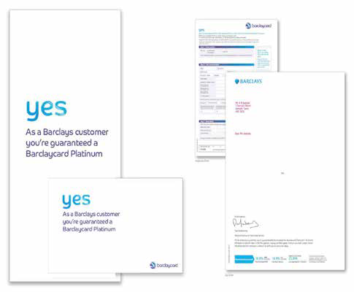
MAILPIECE LAYOUT TEST
REDUCING THE COST TO SERVE
USING CREATIVE TO UPLIFT ROI
Backgound:
Barclaycard wanted to get cut-through in a cluttered offer-led credit marketplace, where 0% offers were routine but people did not not always qualify. They used pre-qualification data to identify the customers that were already qualified for a 0% offer. To stand out, the creative solution needed to grab attention.
Solution:
The pack communicated that customers had been preapproved for a Barclaycard Platinum card. An incredibly simple direct mail pack held nothing more than a one-word “YES” and an application form. This gave it real standout against other credit card communications
Results:
Response was incredibly strong, with uplift in recipients applying of 36% against the control pack. And just as importantly for Barclaycard, it proved that a more creative pack could significantly uplift response – a learning that was taken forward into other areas of Barclaycards’ direct marketing.

Slide 39
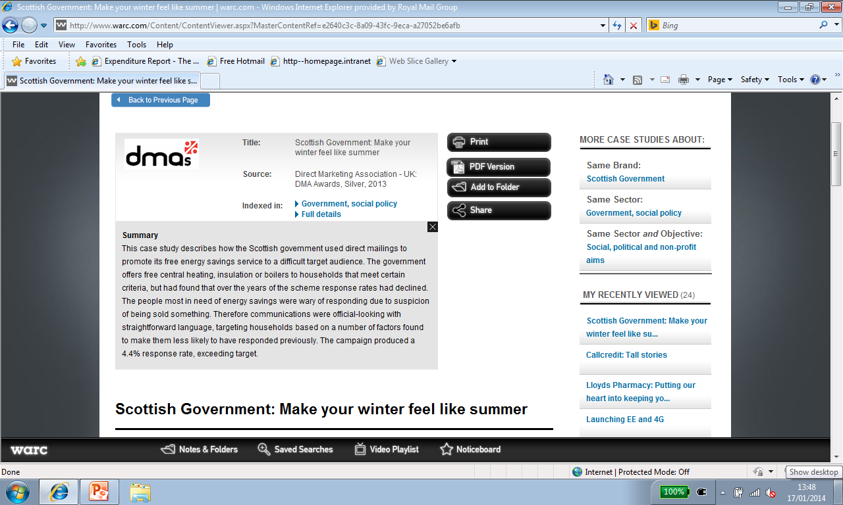
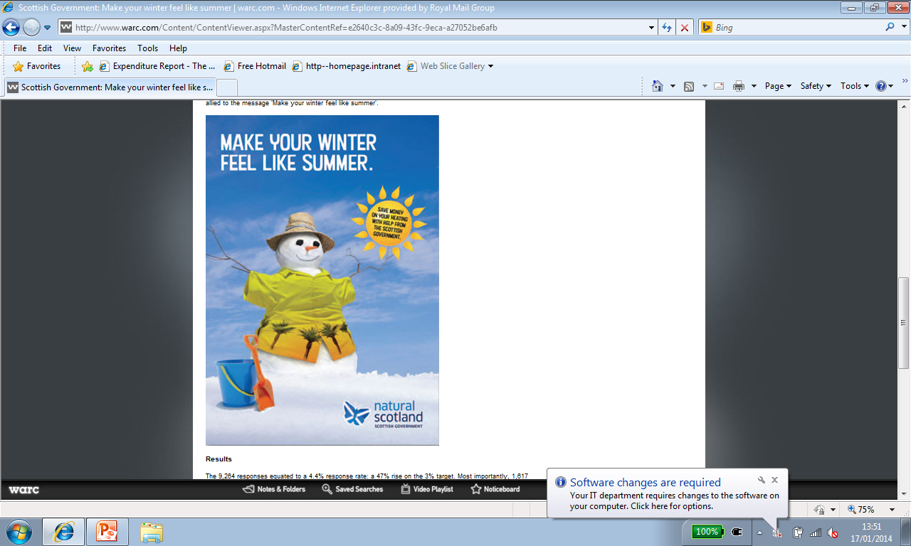
SCOTTISH GOVERNMEMT
Scottish Government: Make your winter feel like summer
Direct Mail 2013
Case studies from WARC
Notes:
39

Slide 40
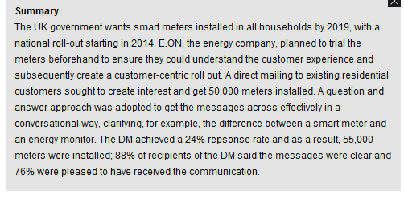
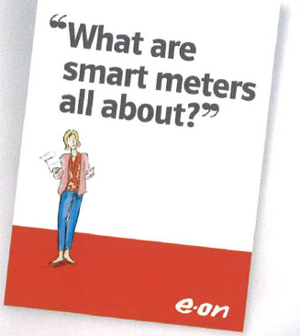
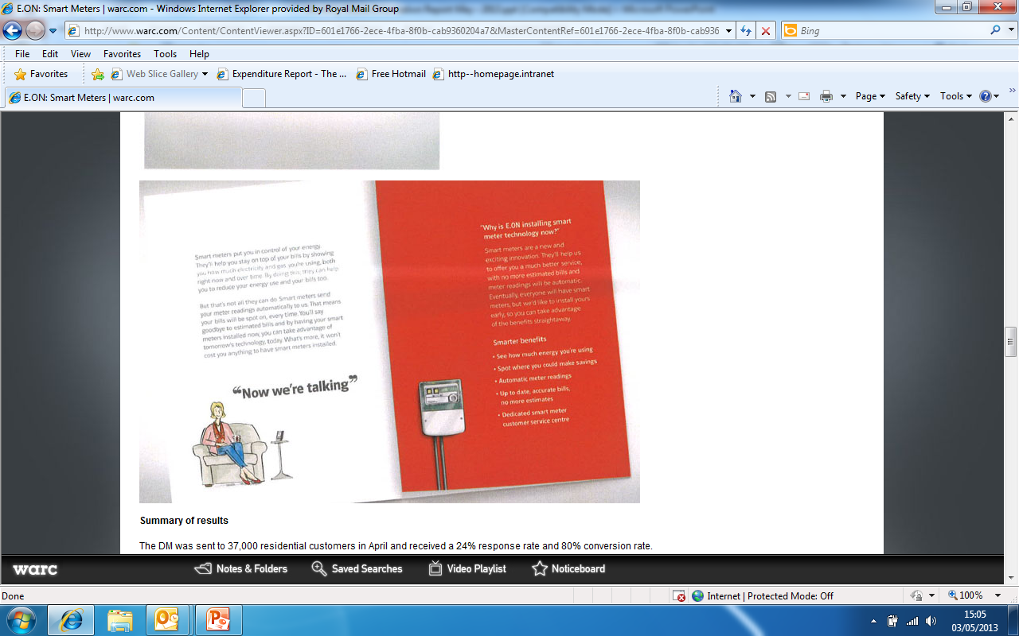
CASE STUDIES FROM WARC E.ON
2013 Direct Mail
Courtesy of WARC
Notes:
40

Slide 41

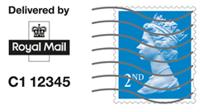
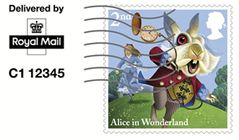
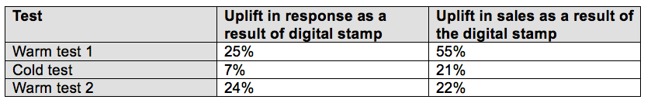
DIGITAL STAMP - THE CHANGE
TO UPLIFT RESULTS
Summary
In 2016 Cashmere Centre were looking for a new test to continue optimising their catalogues and improve ROI. A digital stamp is a reproduction of a postage stamp printed directly onto the envelope so it looks like a normal postage stamp.
Cashmere Centre ran 3 tests using a digital stamp indicia vs. standard postage paid impression, two with warm customers and one with cold.
All 3 digital stamp tests beat the postage paid impression control uplifting response and sales.

Slide 42


LOCAL AUTHORITY
Get information out accurately and with impact – Case Study - ROTHERHAM METROPOLITAN BOROUGH COUNCIL
PROBLEM - Rotherham Metropolitan Borough Council send a calendar to 116,000 residents to remind them of their rubbish day and what to recycle in which bin.
Hand delivery had been the cheapest option but led to large numbers of complaints from roads that were missed or had been delivered the wrong calendar with the wrong collection day resulting in increased calls into the Council, extra postage to supply the right calendar and bin crews having to make extra collections.
SOLUTION - In 2015 Rotherham switched from hand delivery to mail delivery meaning: The
right calendar was sent to the right residents, first time, the personally addressed envelope got
more attention and it landed precisely when needed (just before Christmas to inform residents
of the changes).
RESULTS - The number of complaints dropped – saving time and money. The number of
returns fell to 1% too, proving that mail was the most reliable way to deliver the calendar.
Case Study Courtesy of: Paul Hutchinson, Waste Officer, Rotherham Metropolitan Borough Council
Making rent collection more efficient – Case Study - EAST RIDING OF YORKSHIRE COUNCIL
PROBLEM
Up until May 2016, council tenants with significant rent arrears would be issued a
‘Notice to Seek Possession’ (NSP). The NSP was hand delivered by Court Officers –
to satisfy the courts that it had been legally served It could take up to 2-3 days to serve each notice which was an expensive and inefficient use of the Court Officer’s time.
SOLUTION
East Riding of Yorkshire Council tested using Letterboxable Tracked to deliver their NSP’s. A bar-coded Letterboxable Tracked label which contains the tenant’s unique reference number. This meant they Royal Mail could log and track the NSP’s progress of the NSP from the council to the tenant’s home. Royal Mail’s scan of the bar code at the tenant’s home was proof that the NSP had been delivered directly to the tenant or through their letterbox.
RESULTS
This solution has delivered a considerable saving to the Council and has freed up valuable time of the Court Officers who are now able to focus more on recovering other, more lucrative debt.

Slide 43


GREAT REWARDS STOPPED CHURN
Summary
Customers had got used to having to change providers to secure the best rewards. Through bespoke research into the meaning of ‘value’ in UK culture Virgin Media discovered that discounts and money off wouldn't change value perceptions. So they set about identifying how they could deliver something that every one of the 91,000 in the highest risk segments would really value. Using customer data Virgin Media categorised customers most likely to churn and from this they created micro-segments and allocated tailored upgrades to their packages. By giving these customers just a little bit more product for their money, Virgin Media knew they could increase a customer’s perception of value for their subscription.
The creative approach was to ensure that the offer looked and felt like a gift. A strapline that held the campaign together - ‘Just because’ - reinforced the feeling of generosity and no hidden catches. Mail was used, in conjunction with email. The vibrant red envelope that landed on customer’s doormats with the line - ‘We’ve added more to your bundle. Just because’ – demanded to be opened.
Based on the incremental projected annual value from retained customers the ROMI was 179:1

Slide 44
MAXIMISING CATALOGUE VALUE
BY TESTING FORMATS AND OFFERS
Background
Online retailer using direct mail for a number of years was seeking to overhaul their complete campaigns by testing different formats, audience types, additional advertising to coincide with catalogues and different content based on seasonality
Test 1
Catalogue content - new holiday collection including new fashion ranges. Seeking to convert new customers (from cold data lists), to convert existing customers from single buyers into multi-buyers and re-engaging lapsed customers
Test 2
Format – overhaul of the graphic design of the catalogue including a new size, paper stocks and new title and results will be compared to results from the book sent last year
Test 3
Testing sending a SALE postcard to the house file to boost sales
Test 4
Seasonality (testing an altered product offering for late summer) - several years of unseasonably warm weather in September has led to lower than average response rates for many fashion retailers as the customer is not yet in winter clothing shopping mode.

Slide 45
MAXIMISING CATALOGUE VALUE
BY TESTING FORMATS AND OFFERS
Background
Online retailer using direct mail for a number of years was seeking to overhaul their complete campaigns by testing different formats, audience types, additional advertising to coincide with catalogues and different content based on seasonality
Test 1
Catalogue content - new holiday collection including new fashion ranges. Seeking to convert new customers (from cold data lists), to convert existing customers from single buyers into multi-buyers and re-engaging lapsed customers
Test 2
Format – overhaul of the graphic design of the catalogue including a new size, paper stocks and new title and results will be compared to results from the book sent last year
Test 3
Seasonality (change type of product offer for late summer) - several years of unseasonably warm September weather meant lower than average response rates as the customer not yet in winter clothing shopping mode.
Test 4
Testing sending a SALE postcard to the house file to boost sales

