Slide 1
Engage citizens with mail for health messages
February 2020
YOUR LOGO GOES HERE

Slide 2
Not getting consumers to act costs
Notes:
The cost of patients not turning up and not telling surgeries could pay for 2,325 full-time GPs.
bout 307m sessions are scheduled with GPs, nurses, therapists and other practice staff every year, and one in 20 are missed without enough notice to offer them to other patients, according to the latest NHS Digital data.
As well as causing disruption for staff and fellow patients, at £30 an appointment, the amount lost every year could pay the annual salary of 2,325 full-time family doctors, NHS England said.
NHS do not attends cost the healthcare service a huge £1bn in lost time last year, according to NHS’s Chief Nurse. There were eight million missed hospital outpatient appointments in 2016/17 at an average cost of £120 each, according to NHS England figures.¹ Mail is the one channel that can really cut through and ensure people change their appointment if it is not convenient or ensure that the appointment is made.

Slide 3
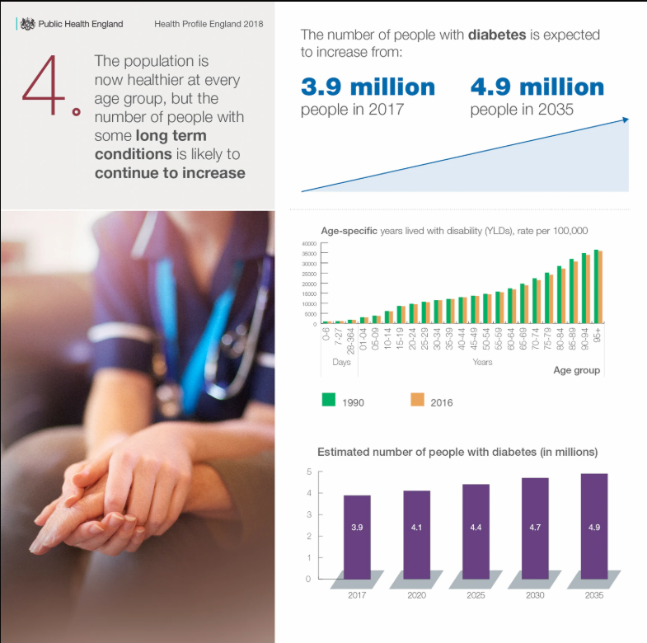
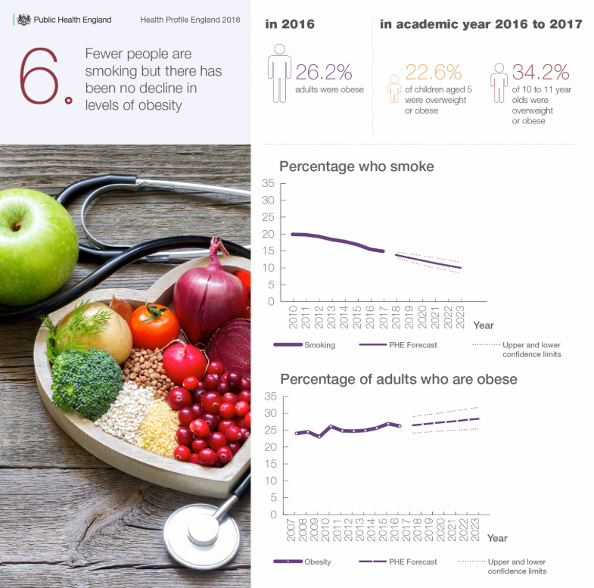
Obesity and diabetes are on the rise
Whilst people are living longer there are big health issues to tackle
Notes:
And on top of that there are some big health issues, that are on the rise. Diabetes is on the rise and so is obesity.
In 2016, one in four adults was obese - and Public Health England expects levels of adult obesity may continue to rise.
Poor mental health is also taking a significant toll.
In young people, mental health problems, such as depression and anxiety, along with substance use, now account for a third of all ill health.
One of the biggest challenges facing health and social care services is demographic change. The population has increased steadily over recent decades. At the same time the population has also been ageing and in England in 2017, the proportion of the population aged 85 and over was 2.7 times greater than it was in 1971.
This ageing population is placing additional pressures on the NHS, as well as impacting on families, and our workplaces. Those aged 85 and over are the largest users of health and social services and this population will increase substantially in the future, particularly when ‘baby boomers’ born after World War 2 move into this age group.

Slide 4
And for consumers health is a personal matter
Fundamentally health communications are personal and confidential which makes it important to people.
It also provides a persistent, tangible reminder to change or modify behaviour which is a process that sinks in gradually over time.
I would prefer to have hospital appointments on paper so I could refer to it quickly than having to go through and sort through
emails.
Sharer, Gateshead
If you've got a letter for an appointment… I
can keep referring back to that to know when the appointment is… for me with health matters then I do like to have it through the post.
Empty Nester, Solihull
(keeps her health correspondence in her diary until she has ‘completed’ the task or appointment)
It works well because a letter invites a response – it’s a prime example of where mail can encourage you to respond if its made easy to do so.
Retiree, Lambeth
Source: Royal Mail MarketReach Research conducted by Kantar TNS in May 2017: Base 1269 UK adults, nationally representative sample
Notes:
When we talk to consumers they tell us they value getting mail about appointments and they can refer back to it.
It also prompts people to make changes to an appointment if it isn’t appropriate.

Slide 5
Mail from healthcare sector cuts through
At a higher rate than average
98%
96%
Engaged
Minimally processed
Healthcare
n=2365
All mail
n=33829
ENGAGED: % of mail processed in some way including – opening, reading, sorting, put aside for later, filed, put on display, put in the usual place.
MINIMALLY PROCESSED: % of mail thrown away only.
Source: JICMAIL Q2 2017 – Q1 2018. Engagement rate
Notes:
Mail from medical / healthcare brands gets cut through, 98% of it is engaged with in some way, which means it is opened, read, sorted or put aside. Only 2% of it is minimally processed ie just thrown away or recycled.
That compares to 52% of emails being deleted within 2 seconds of receipt.

Slide 6
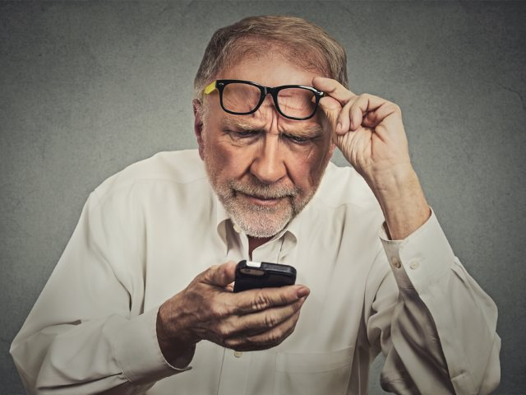
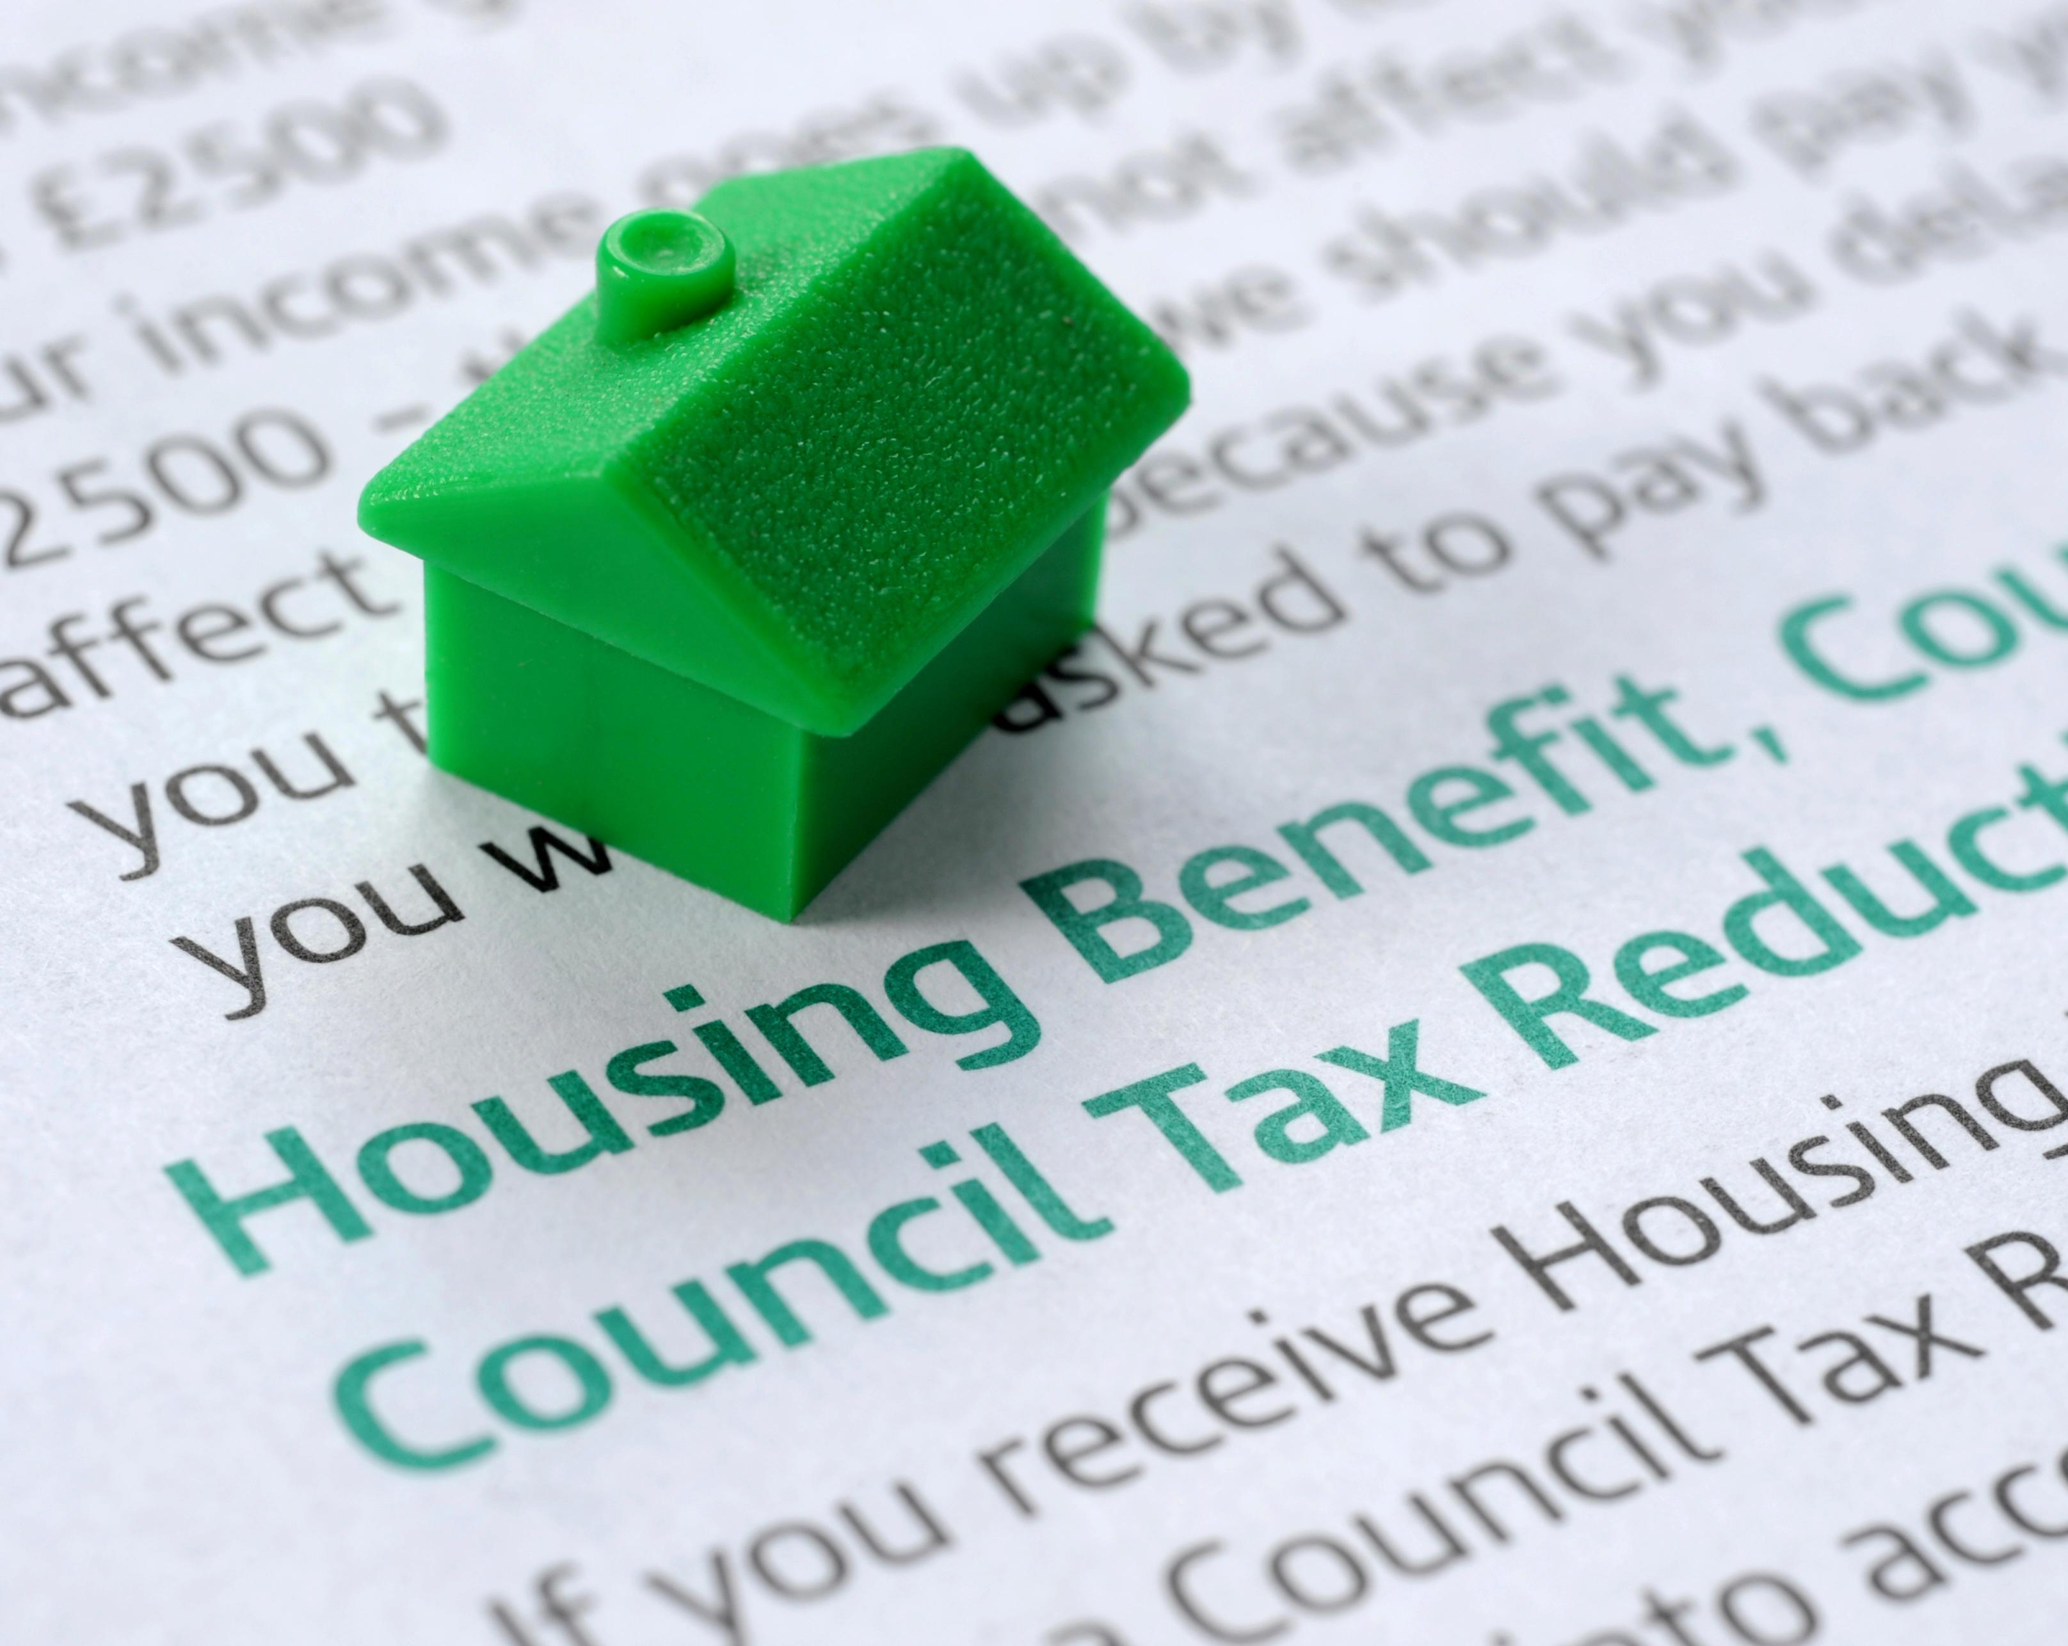
Mail can reach everyone
Including some of those audiences who are hard to reach
10% of the UK are still internet non-users, not used in the last 3 months or ever
Not used the internet at home
Age 65+
Index 269
Not used the internet at home
Social grade E
Index 244
Not used the internet at home
Those receiving housing benefit
Index 149
Source: TGI, Q1 2020, ONS 2019
Notes:
Whilst internet usage has grown there are still audiences who are harder to reach online.
Those over the age of 65 index at 269 who have not used the internet at home in the last 3 months or ever. An index of 100 or more is significant, so 269 is high.
The same is true of social grade E and of those on Housing Benefit.
So whilst digital is cheap it doesn’t necessarily reach all the right people.
One of the biggest challenges facing health and social care services is demographic change. The population has increased steadily over recent decades. At the same time the population has also been ageing and in England in 2017, the proportion of the population aged 85 and over was 2.7 times greater than it was in 1971.
This ageing population is placing additional pressures on the NHS, as well as impacting on families, and our workplaces. Those aged 85 and over are the largest users of health and social services and this population will increase substantially in the future, particularly when ‘baby boomers’ born after World War 2 move into this age group.

Slide 7
mail is preferred by all age groups
For Health and wellbeing communications
Mail
Email
Social media
Text message
16-29 year old's
65+ year old's
Source: Local Government Research 2017 Royal Mail MarketReach, Illuminas
Notes:
Despite what people might think whilst it is clear that the over 65s clearly prefer mail for health and wellbeing communications at 59%, surprisingly 16-29 year olds still rank mail as their top channel and are slightly less disposed towards email.

Slide 8
Mail helps overcome barriers
MAIL IS MORE LIKELY TO BE READ IN FULL EVEN IF READERS’ VIEWS ARE NOT REFLECTED
Extent to which communication has been read / consumed which somewhat / strongly differed from my views.
Source: Communications in Electoral Engagement, Royal Mail MarketReach, Illuminas 2017
Base: All answers on communications which somewhat / strongly differed from views by media (excluding leaflets & magazines)
Notes:
And some healthcare messages are not necessarily things that people want to hear or think about. Eating better, stopping smoking and engaging with screening programmes are not always topics people want to engage with.
But mail and door drop, for that matter, have the ability to get people to read the full message, even when they don’t agree with the contents.

Slide 9
Reach & frequency is good for healthcare
It out-performs average physical interactions
REACH
How many people see mail
FREQUENCY
How many times people revisit mail
Source: MICMAIL, Q2 2017-Q1 2019 Addressed advertising/Business Mail. Bases: All Mail 72,595, Healthcare Mail 5,186
Notes:
The Joint Industry Committee for mail or JICMAIL collects data from 1000 households every month on what they do with their mail.
They do this to ensure that people planning mail have the same metrics as all the other channels like TV, Radio and Outdoor. They use these vital metrics to plan media campaigns and assess their overall impact.
Healthcare mail reaches more people than the other sectors combined. So for every 100 healthcare mailing packs sent they are seen by another 17 people.
And they are returned to, on average 4.7 times, over and above all sector, which achieve 4.4 revisits.

Slide 10
Physical engagement high
YOU ARE MORE LIKELY TO open it AND LESS LIKELY TO THROW AWAY
Source: MICMAIL, Q2 2017-Q1 2019 Addressed advertising/Business Mail. Bases: All Mail 72,595, Healthcare Mail 5,186
Notes:
When we talk about physical engagement we are tracking what consumers do when they have the mail pack in their hand.
You can see that healthcare pieces have high open and read rates. They are more likely to file it and less likely to throw it away or recycle it.

Slide 11
Mail interactions are high
As well as physical actions 32% of people do something else – healthcare mail drives 46% of people to act
Actions per thousand mail packs
Health mail drives a lot of discussion
And considerably higher interactions, showing people are contacting the sender
Less activity is driven online
Source: MICMAIL, Q2 2017-Q1 2019 Addressed advertising/Business Mail. Bases: All Mail 72,595, , Healthcare Mail 5,186
Notes:
In addition to the physical actions consumers track the other things they do with their mail, that JICMAIL don’t classify as physical, as the mail pack may not be in their hand.
A high percentage of healthcare mail prompts this sort of behaviour.
From this you can see that healthcare mail prompts a lot of discussion, so it is talked about in the household and it prompts 190 people out of every thousand to contact the sender. This can only help to avoid appointments being missed.

Slide 12
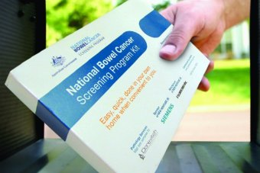
cost effective health screening
For Bowel cancer screening
Each hospital appointment is estimated to cost the taxpayer £108.
The NHS use direct mail to send samples for bowel cancer screening to 60-74 year old's.
Estimated cost of 1 x bowel cancer screening pack = £3-£4.
Saving money and providing a cost effective way of screening.
Source: Philip Kelly, Manager, North East Bowel Cancer Screening Programme Hub

Slide 13
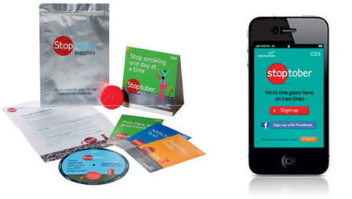
Mail helped smokers quit
A mail support kit helped those trying to quit for stoptober
There are over 8 million smokers in England with an annual NHS cost of £5bn
Stoptober was launched to invite smokers to quit with the help of a mail support kit, an app and SMS service.
Stoptober contributed to a nationwide decline in adult smokers by 2.5%, resulting in 70,000 fewer smokers.
The ROI was £2.85 for every £1 invested.
Source: Warc - Institute of Practitioners in Advertising, Gold, IPA Effectiveness Awards, 2016
Notes:
Background
Bowel cancer is the third most common cancer with 1 in 16 males and 1 in 20 females developing the disease in their lifetime. Early detection saves lives, so the National Bowel Screening programme was set up in 2006 to inform anyone aged 60 or above about bowel screening and encourage participation. This programme is central to meeting the target of reducing bowel cancer rates by 16%.
The North East Bowel Cancer Screening Programme Hub is one of 5 hubs in England that is tasked with getting over 60s to participate in screening.
Solution
North East Bowel Cancer Screening Programme Hub delivers an extensive, rolling mailing programme.
A national piece of software kicks off the programme by selecting anyone aged 60-74 years old who is registered with a GP. If they have never been contacted by the Bowel Screening Programme or are due to be re-contacted (every two years), they will be automatically be sent a letter inviting them to take part in screening and informing them that a test kit will arrive in the post over the next week. In the North East this results in approximately 3,000 invitation letters being mailed every day.
8 days after the letter arrives, a test kit is mailed to the same people with instructions on how to complete the test. All completed tests are sent back to the North East Bowel Cancer Screening Programme Hub where they are tested immediately. Within 48 hours of returning the test, the participant is sent a letter through the post informing them of their results. Bowel cancer is something that most people would rather ignore, but the physical presence of the kit in the home acts as a nudge to complete and return the test.
Finally, North East Bowel Cancer Screening Programme Hub believe the gravitas and highly personal nature of the results – either positive or negative – makes a letter the best medium to deliver them; the letter is addressed directly to them and participants can open and read the results in the privacy of their own home at a time that suits them.
Results
The minimum uptake target in the programme nationally is 52 %– through the use of mail - North East Bowel Cancer Screening Programme Hub consistently hits that target. (an uptake of 57.48% was achieved in 2015-16).
“Everyone has a letterbox but not everyone has email – with mail we can be confident that our invitation will reach everyone in their own home.” Philip Kelly, Manager

Slide 14
Exclusive invitation
Gets the other half involved in buying
AUG/SEPT 2018
C2
NORTH EAST
21
ITEM ARRIVES
23
FEMALE
23-34
HHC
MALE
35-44
5
MALE
0-16
REACH = 2
FREQUENCY = 15
COMMERCIAL ACTIONS = 4
STI IN THE HOME
Source: JICMAIL Examples Database Q2 2017 – Q3 2018
Notes:
This appointment mailing, recorded by a household no the JICMAIL panel arrived on the 21st August.
On the first day it arrived it was opened, put aside to look at later, read, discussed with the male of the household, was used to do something and was filed.
On the 23rd of August it was opened, read, put in the usual place, discussed again and put on display.
And then finally in the 3rd of September it as read twice, put in the usual place, opened, used it to do something with the information, looked up their account details, discussed with someone and taken out of the house.
That amounts to 2 people in the household being exposed to the message and physically interacting with it 15 times and 4 times doing something more than physical ie more commercial like discussing it, looking up account details, which JICMAIL log as commercial actions.

