Slide 1
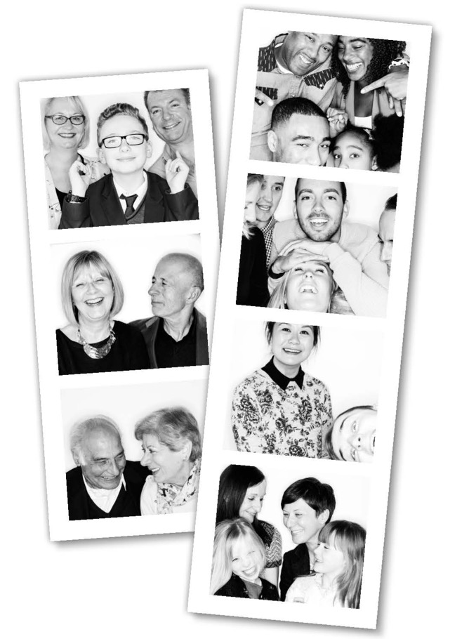
the
Life stages
Of mail
ALL LIFE STAGES READ AND RESPOND
TO MAIL
June 2016

Slide 2
Objective: Provide insight TO HELP
GUIDE mail EXECUTION AND Measurement
How different life stages use mail
How digital savvy consumers use mail
Notes:
When new technologies become mainstream, many assume that the previous technologies will become extinct. Cars eliminated horse drawn carriages, electric lamps eliminated gas lamps, etc.
The embrace of digital communication – particularly by younger generations – has led some to wonder if direct mail is doomed; there seems to be a concern that mail is only really relevant for older people, and that as today’s younger people grow older, mail will become an historical artefact. Clearly, this is an issue of great importance to RM; but is the concern justified? Are younger people, and those of any age who are particularly digitally savvy, turning away from mail?
We clearly needed to investigate this issue. We set up a research based project with the objective of understanding the similarities and differences between different ages/life stages of people regarding how they engage with direct mail and door drops. We wanted to explore not only the influence of age/life stage, but also the reactions of the most digital savvy consumers.
A key part of the project was to collect the information and insight required to help our advertisers create even better mail for the different groups if we found there were significant differences in how they engaged with the medium.

Slide 3
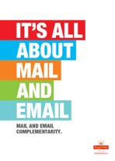
REVIEWED EXISTING RESEARCH, INDUSTRY
SOURCES AND COMMISSIONED NEW RESEARCH
The life stages of mail
Notes:
To meet our objectives we knew we would have to commission new research.
But MarketReach has a substantial amount of both proprietary and subscription research to hand. So in addition to having Quadrangle and Trinity McQueen – two highly respected independent research agencies - conduct in home, face to face qualitative research (including week long diaries of addressed and unaddressed mail received and actions taken) we also reviewed other material.
This included quantitative and qualitative research we commissioned in the past 3 years and have previously published (specifically in ‘It’s all about Mail and Email’, ‘The Private life of Mail’, and ‘This Time it’s Personal’). We knew that within the data there would be relevant material to help us.
But we also drew heavily on industry research sources including the latest updates of TGI, Ebiquity, and Touch Points.
The report therefore has a wealth of evidence that provides both depth and breadth of substantiation to our findings.
The full report is available at mailmen.co.uk, but this presentation provides a resume of the key findings.

Slide 4
LIFE STAGES - A MORE IMPORTANT PREDICTOR
OF MAIL BEHAVIOUR THAN AGE
Fledglings
Sharers
Couples
Young Families
Older Families
Empty Nesters
Older Retirees
Notes:
These are the stages we opted for. The definitions are below. These segments cover about 87% of the UK population; those not covered include single adults living alone prior to having children, and individuals living in facilities such as prisons, care homes, dormitories and hospitals. We chose it because 7 segments seemed about the most we could deal with practically; all segments were living with someone else (important to our understanding of sharing - a key response to mail); and detailed enough to explore sensitively any differences.
Fledglings: adults living in the home of their parents
Sharers: adults living in shared accommodation with other adults who are not their partners
Couples: neither children nor other adults in the accommodation
Young Families: have one or more children none of whom are above primary school level.
Older Families: have at least one child at secondary school living at home
Empty Nesters: no longer have children living at home; one or both partners economically active
Older Retirees: singles or couples where neither partner has an income other than from pensions or investments
The report looks at each group regarding their engagement with and use of mail.
But before we do that, its important to be clear that the differences are nuances. The overwhelming evidence from the quantitative difference is that people of every age engage with - and respond to – mail.

Slide 5
ALL LIFE STAGES READ, ENGAGE AND
RESPOND TO ADDRESSED MAIL
By life stage, all groups cluster close to the average
26.7%
bought or ordered from direct mail in last 12 months*
Fledglings
23.3%
Sharers
21.7%
Couples
26%
Younger Families
29.6%
Older Families
26.9%
Empty Nesters
25.8%
Older Retirees
31.7%
*Source: TouchPoints 6, 2015
Notes:
Our exploration of a wide range of sources made clear that while there are some differences and age/life stage related trends, all life stages engage with mail. The figures above record responses only, but in the report we look at many different perceptions of mail and the responses were very similar. So our key finding – one that may be highly surprising – is that young people – and digerati of all ages – read, engage with, share, display, and respond to mail. It is not a medium that is only relevant to older people. As the data shows, the range of claimed response rates to a mail item over 12 months varies from around 22% to around 32%. No life stage varies from the average by more than 20 index points – a benchmark often used as the minimum required to indicate a real and substantial difference. In fact when the volume of mail received is overlaid – younger life stages receive a lot less mail than the older stages – the similarity in response is even more dramatic (though for data reasons we can’t calculate it numerically).
The simple fact is that there is no ‘no go’ group that can’t or shouldn’t be mailed. The idea that mail will die as a result of the younger age groups failing to engage with it is just as fanciful as was the idea that cinema would kill theatre, TV would kill cinema, video would ‘kill the radio star’, or ‘clicks’ would kill ‘bricks’.
This should be one of the key points for marketers to take away.

Slide 6
… BUT HOW THEY RESPOND VARIES
The channels used by those who bought/ordered varied by life stage
Source: TGI, Q3 2015: Multiple answers allowed
6
Notes:
But it is just as important to point out that how the different life stage groups responded were different, particularly in one key dimension: how they responded. This is essential in understanding how to accurately design response communications and develop appropriate measurement tools.
For example, the Older Retirees were the group most likely to use the post to respond, and Empty Nesters the group most likely to use the phone.
Other groups were far less likely to use these channels to respond. But the group most likely to use the internet to respond (either by PC/laptop or smartphone/tablet) was the Young Families, not the Sharers or Fledglings – typically the youngest of our respondents.
So at its simplest level, the call to action and measurement for campaigns aimed at these different groups need to reflect these differences. In short: all life stages engage with mail, but the way they respond is influenced by their life stage.
There were, of course, other differences – nuances that can be used to help optimise mail items. In the report, we look in depth at each of the life stages and provide tips on how advertisers can leverage these differences to create great mail. The remainder of this presentation takes a quick look at some of the key differences and how to use them to an advertisers advantage.

Slide 7
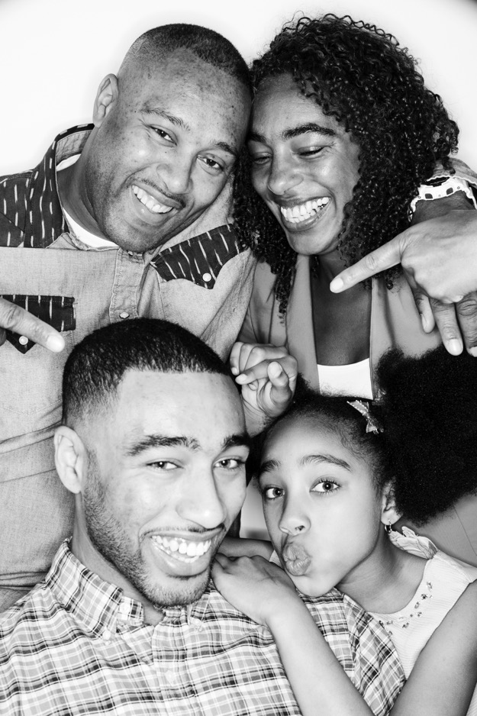
FLEDGLINGS
3
circa
million people
52%
of Fledglings are 18-24 years old
23%
bought / ordered as a result of addressed mail
38%
Agree they are more likely to look at mail that is printed on high quality materials
+32%
more likely to say they trust information in print than on the internet
+ = index percentage.
Source: TGI, TouchPoints, 2015
Notes:
Fledglings are adults who still live in their parent(s) home.
As the chart shows, 52% are 18-24 years old. Yet their response level is very close to the norm, proving that they are not a ‘no go’ group for direct mail.
A key factor about this group is that they are very much in the process of figuring who they are and what they really want. The “selfie generation” is looking to establish, maintain, and exert itself or themselves in terms of others. Accordingly, Fledglings are more likely than the norm to agree to statements such as “I like to go to trendy places to eat and drink”, “I am more influenced by my friends these days” and “I feel the need to check social networking sites everyday”.
This includes defining themselves in terms of their career– and their independence and – perhaps most important – their peer group. They are sending out – and sensitive to – signals that help them gain social status. This is important when considering how best to communicate with them by mail.
And despite – or perhaps because – they are digital natives, they are more likely than the sample as a whole to trust the printed word over the internet.
It is clear that despite this positive attitude, advertisers don’t seem to use mail to target them: Figures from Ebiquity suggest many advertisers think so; in 2015, 16–24 year olds received substantially less mail than other age groups, and most of our Fledglings are in this age bracket

Slide 8
FLEDGLINGS: KEY OBSERVATIONS
AND RECOMMENDATIONS
Fledglings are conscious of their social status and identities
The design, tone and style of mail should help define the brand but also encourage their desire to share which supports their social self
Mail is novel
Make it clear that this item is for them not their parents and guide them through next steps; giving them both digital and analogue options
Mail engages and stimulates
Leverage relevant content, imagery and tactile engagement to savour or share
Notes:
Fledglings are seeking social status and positioning
How a brand represents itself in the post is noticed. Does it feel right for them? Is this a brand I might consider either now or in the future? What would my friends think if they saw it – or think of me if I showed it to them? The creative expression should deliver positively on these dimensions, as mail as a channel has more gravitas than email or other messages.
Mail is novel
Fledglings assume mail coming to their house is for their parent(s). They don’t get much addressed mail, and when they do it may be nothing more than a bank statement, as they aren’t on as many customer lists. Their lack of familiarity means that mail for them really can be rewarding – but they need ‘help’ in realising it is for them, and even in understanding what to do with it. Interestingly, they can share mail not only within the household, but with others: sharing is not limited to online activity
Mail engages and stimulates
Because so much of their communication is digital, mail engages them: its new and different as well as having tactility. They are looking at the format, creative idea and core proposition harder because they don’t have the familiarity of older people. They are also appreciative of print’s inherent creative qualities. Almost half (47.8%/ index 110) agreed that “The quality of printing and material in a piece of mail tells me something about the organisation that has sent it.” And 38% of them (index 116) agreed with the statement “I am more likely to look at mail that is printed on high quality materials”. In fact Touch Points indicates that Fledglings are generally positive towards mail. They are more likely than the population as a whole to welcome it – 21.4% agreed with this (index 118) – and to find it memorable.

Slide 9
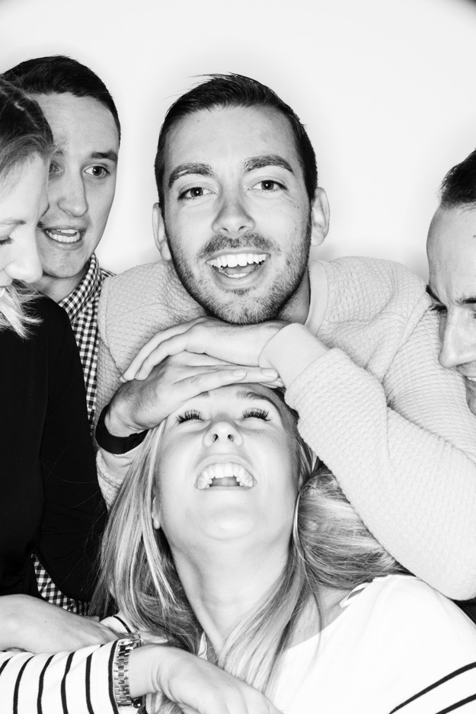
SHARERS
1.9
circa
million people
51%
of Sharers are 18-24 years old
22%
bought /ordered as a result of addressed mail
+49%*
to feel reassured about a company or product after receiving mail
+75%*
more likely to buy/order from a door drop
+ = index percentage.
Source: TGI, TouchPoints, 2015
Notes:
Sharers are adults living with other adults with whom they are not in a relationship. This could be in a dorm, house or flat. With just over half of these people being 18-24, they are typically at the start of their independent lives, and not yet ready to settle into a relationship. Like Fledglings, they are still heavily engaged in defining themselves in a social context.
Sharers live in flats or homes with others, sharing the costs involved. For many, it is a first step when starting tertiary education or a first job.
Sharing is (for most) a transitory period of a person’s life; this includes not only their residence but also their relationships with companies. Typically there appears to be one person who is generally the named individual for bills, etc.; so many may not receive much in the way of addressed mail.
Often they are financially restricted; unlike those living at home they have to contribute to everyday costs like utilities, rent, and food; and they may still be on ‘starter salaries’/very low income.
So its not surprising that they are the least likely to say they responded to a piece of addressed mail. But they are relatively positive about mail generally, and are most likely to say they responded to door drops.

Slide 10
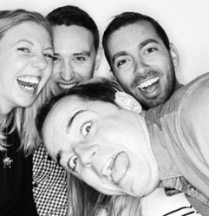
SHARERS: KEY OBSERVATIONS
AND RECOMMENDATIONS
Like Fledglings, Sharers are socially focused
The design, tone and style of mail should help define the brand and also encourage their desire to share which supports their social self
Addressed mail is unusual
Create personalisation that stands out on the doormat
Communality creates sharing ‘by default’
Keep the execution open for sharing; consider door drops
Value is important to them
Make sure value messages are clear and upfront
Design for mobility
Make it easy to use on the go
Notes:
Like Fledglings, Sharers are socially focussed
Sharers index highly on spending a lot on clothes, wanting to go to trendy places to eat and drink, wanting to stand out in a crowd and being more influenced by friends. In fact, 57.1% of them (index 187) agree with the statement “I often compare what I do with others in my social circle”. But they may lack the resources: 30% say they find it difficult or very difficult on their present income. Again, the design and creative expression should reflect their desired social positioning.
Addressed mail is unusual
Many sharers don’t have lots of existing relationships with companies and can be in relatively short term accommodation; so as with Fledglings they don’t seem to get much addressed mail. Moreover only a relatively small amount take responsibility for looking at and sorting through the mail. So Sharers aren’t looking out for unsolicited mail. Having said that, they do appreciate mail from their chosen suppliers that reinforces the style and brand values that made them choose the brand in the first place. Optimised mail should powerfully communicate ‘This is for you!’
Communality creates sharing ‘by default’
In shared accommodations mail is often left on display before and after being looked at by the addressed recipient. This is particularly true of door drops where an item may be brought into the house, displayed in a public area (on the fridge, counter, etc.) and even jointly acted upon. Messages that invite sharing (overtly or covertly) can be more impactful.
Value is very important
Sharers may lack the resources: 30% say they find it difficult or very difficult on their present income. As mentioned, this audience often is living on a budget. They are not heavy users of vouchers, but this may be because they don’t receive many (other than door drops). This group can be recruited, and will provide personal details if the communication has clear value to offer.
Design for mobility
In qualitative research we saw some of these respondents taking mail items with them and engaging with them on their commute or at work. This leads to an interesting opportunity to create packs or elements of packs that are optimised for ‘on the go’ engagement.

Slide 11
COUPLES
circa
6.4
83%
million people
of Couples are 18-54 years old
26%
Bought/ordered as a result of addressed mail
13%
tried a new product as a result of mail
22%
visited a store as a result of mail
+ = index percentage.
Source: TGI, TouchPoints, 2015
Notes:
On one level, it’s easy to define Couples: two people living together as partners with no children or other people in the accommodation. But it’s far harder to define them in other ways.
From 18 to 54 they are more or less evenly distributed across the age ranges ( 36% 18-34, 47% 35-54). We can’t know what commitment they have to each other, and thus what level of planning for the future they are making. Some are in the early stages of a relationship; some may have committed to each other and be considering having children; and others may have lived together for many years and have no intention to have a family. But what they share is the opportunity and requirement to focus on each other both emotionally and practically in a manner that is obviously very different from Sharers or Young Families. To seeing the world in terms of ‘My Parents Family’, ‘My Gang/group’ and ‘Myself’ new perspective is added: ‘ Me and my partner’.
Thus the sharing, discussion about, and actions taken as a result of a piece of mail are different in nature than other groups.
Analysis suggest that in both attitudinal and behavior, this group bridges the gap; they have some of the ‘lightness’ of the sharers, but are beginning to develop more mature and responsible perspective of the young family respondents.
In terms of mail, this means they take it slightly more seriously than Sharers, but less than Young and Older Families.
Couples are often socially focused: they are not absorbed by their own children. They are still more interested in their friends than other groups, and spend money on clothes and going out.
This group tends to be very close to the average of all the groups in the majority of its responses to a wide range of questions. In short they take mail and its contents more seriously than
Sharers, but less than Young and Older Families

Slide 12
COUPLES: KEY OBSERVATIONS
AND RECOMMENDATIONS
Still socially focused but leading more grown up lives
Make mail look stylish and fun but a bit more ‘mature’
Adult responsibilities to partners and home are growing
Mail is often shared and key decisions often taken jointly; consider content and language with this in mind
For many, their residence is becoming a ‘home’
Mail is seen within the context of their (often limited) living space: clarity and relevance of proposition is important to ensure reading
Beginning to have deeper relationship with local community
Enhanced role for content covering home and local community
Notes:
Still socially focussed but leading more grown up lives
Couples still want and need to position themselves in a social context so a stylish execution remains important; but the style that is desirable may well be a bit more mature than that used for Fledglings or Sharers.
Adult responsibilities to partners and home are growing
Adult responsibilities to homes and partners mean mail requires more serious, shared and structured management. As they engage with their home and consider new products and services, mail can have a significant impact. Write copy that acknowledges the fact they may want to discuss with others/potential for joint decision making
For many, their residence is becoming a ‘home’
Couples tend to live in smaller premises. Mail may therefore take a shorter journey round the home. Possible shortages of filing or storage space mean mail imagery needs to be strong to demand attention. It also means mail may be dealt with outside the home, so digital response mechanisms should be included. Overt messages both on the envelope and in the content will help drive attention and action, especially with the inclusion of digital response channels.
Beginning to have deeper relationship with local community Couples are not only engaging with their home, but also their local area. Door drops by local businesses or local operations of larger companies are likely to resonate.

Slide 13
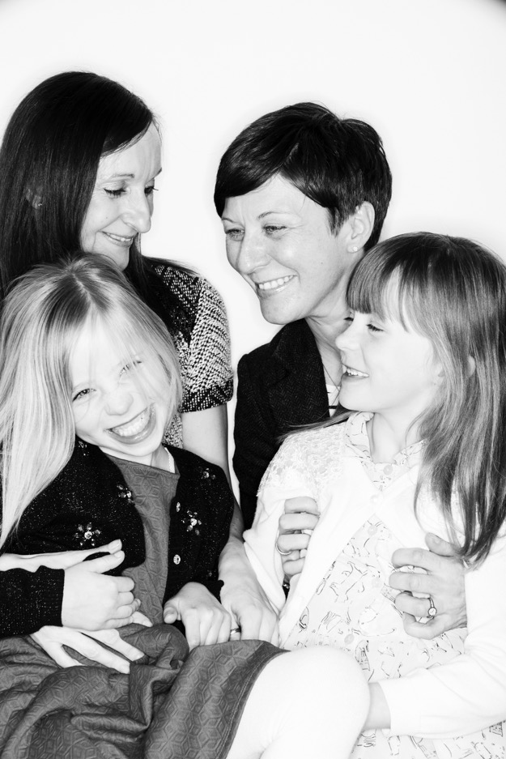
YOUNG FAMILIES
circa
8.5
69%
of Young Families are 25-44 years old
million people
30%
Bought/ordered as a result of addressed mail
+52%
more likely to say ‘could not live without internet on my smart phone’
more likely to have responded using internet on a smart phone/tablet
+92%
+ = index percentage.
Source: TGI, TouchPoints, 2015
Notes:
Few moments in life have such a fundamental impact as the birth of a first child. So much changes; there are so many new things to learn about and deal with. It comes as no surprise that the shift in attitudes and behaviours from Couples to Young Families is one of the most dramatic we observed.
The responsibilities of parenthood mean Young Families need to connect with new types of products and services. They do so enthusiastically because their desire to be good parents is so strong. This means they are exceptionally positive recipients of mail, as the chart above shows.
The business of their lives and their relative youth means they are heavy users of the internet - and in particular smart phones and tablets - as response channels to mail.
Along with time poverty, many experience more challenging financial circumstances too – they want to create a real home, but kids are always more expensive than you think, and the household income may be limited, so value is an important message.
And when they manage to get a few moments to relax, an inspiring catalogue, brochure or other tempting window shop featuring lovely relaxed offerings can have a real advantage.

Slide 14
YOUNG FAMILIES: KEY OBSERVATIONS
AND RECOMMENDATIONS
New life creates new questions, needs and responsibilities
Appeal to them in their busy family roles; let content drive engagement
Time is precious
Make it simple and clear; make digital the default response channel
Price consciousness rises
Highlight value offers
Time poverty creates appreciation of quiet moments
Certain brands/packs can leverage their need to relax
Notes:
New life creates new questions, needs and responsibilities
Unlike younger consumers, Young Families are less worried about the social impression the pack creates and more about whether or not it has something useful for them in their parenting role for them. Make sure mail reflects their life perspective; they may be tired or worried, but they passionately want to do the best for their family.
Time is precious
Make sure mail quickly communicates the content that has value for them rather than trying to intrigue them. Young families are heavy users of mobile/tablets, and will often use these to respond to mail as the have very little time to sit and ponder. Clear digital response mechanisms make it easy for them and allow multi-tasking. The exception is vouchers which they appreciate, because they are often tight for money
Price consciousness rises
Young Families become more price conscious as costs rise and in some cases income – perhaps only temporarily – falls. They are the heaviest users of vouchers. Make sure the financial value of the item of mail – whether directly in terms of vouchers or in other ways – is clear and to the fore.
Time poverty creates appreciation of quiet moments
The chance to sit down with a cup of tea and savour a beautiful catalogue is highly appreciated. For advertisers who can help them indulge themselves, this is a great opportunity. The creative work should provide a reward, and be easy to respond to, rather than urgent or demanding.

Slide 15
OLDER FAMILIES
circa
3.7
63%
are 35-54 years old
million people
27%
Bought/ordered as a result of addressed mail
52%
used a voucher in past 12 months
39%
budget for every penny when household shopping
+ = index percentage.
Source: TGI, TouchPoints, 2015
Notes:
Mail is fully integrated into Older Families lives. They receive a lot of it, including a higher proportion of mail from companies they currently have a relationship with than any of the previous groups And they read, display, share, and respond to it all at levels above average.
This life stage seems to be the most communal of all the different groups. Older children are more able to share in the life of the household rather than simply be its focus. Choices about activities, products and services are more likely to be discussed with partners and children rather than the partner alone. The manner in which this group engages with their mail reflects this. Older families are more likely than most to share the management of mail, from opening it to checking, paying bills, and filing it.
They also over-index in terms of their positive associations with mail, including finding it welcoming, useful, memorable and informative. Thus they are generally warm to mail.
But – yet again – a key attribute of this life stage seems to be that many seem to feel financially stressed; older children’s needs – food, clothes, holiday, even education – can be much more expensive than those of younger children. Given this, value messages are highly valued.

Slide 16
OLDER FAMILIES: KEY OBSERVATIONS
AND RECOMMENDATIONS
The family is the core unit
Consider how design and content might work for the whole family rather than just the intended recipient when the piece of mail is shared or displayed
This group can be hard pressed financially
Highlight value messages
Experience and finances means brand selection is considered, not impulse driven
Mail which communicates the brands used by parents is seen and noticed by children: leverage this as appropriate with language and content
Digital communication remains a key life tool
Keep the digital response channel front of mind and make it easy to use digital to engage and respond: including out of home
Notes:
The family is the core unit
In older families mail is often shared and or displayed; vouchers are put on the fridge, holiday catalogues are seen by the older children, and clothing catalogues jointly reviewed. It’s worth considering this in regard to any item of mail: could this be displayed or shared in a home?
This group can be hard pressed financially
As noted, kids cost a lot. Even financially successful families may be feeling hard pressed as their money doesn’t seem to go as far as it used too. Don’t hide the value messages!
Experience and finances means brand selection is considered, not impulse driven
Beyond its pragmatic benefits, mail is used to evaluate – and evangelise – brands to older children. This group is more likely than many to appreciate companies that reward their loyalty, and mail can make them feel more reassured about the products or services the brand provides. Rather than the ‘social sizzle’ of the younger groups, Older Families are more appreciative of substance and to longer term relationships with brands. This gets communicated to the next generation. So appreciate the role the mail item is playing in delivering your brand to more than 1 individual and generation.
Mail informs and drives digital response and action
Keep the digital response channel front of mind and make it easy to use digital to engage and respond including out of home.

Slide 17
EMPTY NESTERS
circa
10
67%
are 55-74 years old
million people
26%
Bought/ordered as a result of addressed mail
32%
renewed a product or service subscription as a result of mail
39%
are comfortable on their current income
+ = index percentage.
Source: TGI, TouchPoints, 2015
Notes:
The peak age for Empty Nesters – couples whose child(ren) have left home, and where at least one partner is still economically active – is between 55 and 64 (36.9%). They have experienced the challenges and rewards of raising children. But (unlike the older retired group) many are not yet limited to pension income alone, so disposable income stretches further: 38.8% (index 155) say they are comfortable on their present income.
While some may be ‘living the dream’ of a life without children at home and their associated costs, others are consolidating and preparing for their retirement by consolidating their finances and product/brand choices. This means they can be less open to new products or services.
Of particular note is that their use of digital technology (to respond to mail and overall) drops significantly. This may be a ‘cohort’ effect, or simply not having children around to help them; but in general they do like print.
Empty Nesters are the group most likely to read a newspaper every day and rely on newspapers to keep them informed. As printed material, mail benefits from this too: 64.2% (index 117) agree they “would feel less in control of their lives if they didn’t have printed copies of important documents”. They are much more likely overall to re-read items they keep, often four or more times for items such as newsletters, catalogues, statements, loyalty mailings and information on local events and businesses. But they get a lot of mail from a wide range of sectors, and are highly selective.
They receive a lot of mail, and used to making quick decisions as to whether it is worth engaging with.

Slide 18
EMPTY NESTERS: KEY OBSERVATIONS
AND RECOMMENDATIONS
Empty Nesters respect printed materials
Longer copy is appropriate if relevant. Overly ‘designed’ or patronising executions are not
‘Living the dream’ – or concerned about retirement?
Show you understand their feelings about the future: consider your message in terms of the reassurance – or inspiration – it communicates
Empty Nesters of the Baby Boomer generation are the original teenagers
They value choice and individuality, and want empowerment: provide a multitude of response channels
They are ageing, not old
Leverage their role as carers and conduits for their parents as well as the younger generation
Notes:
Build on Empty Nesters’ comfort and respect for printed materials
Empty Nesters are the group most likely to read a newspaper every day and rely on newspapers to keep them informed. As printed material, mail benefits from this too: 64.2% (index 117) agree they “would feel less in control of their lives if they didn’t have printed copies of important documents”. They are much more likely overall to re-read items they keep, often four or more times for items such as newsletters, catalogues, statements, loyalty mailings and information on local events and businesses. But they get a lot of mail from a wide range of sectors, and are highly selective. Longer copy can work well if relevant, as they will read it; but they want steak, not sizzle and can be skeptical of hype and over-claim.
Respect their pride in their life experience
Speak to them in a personal yet respectful manner: don’t condescend. They feel their experience counts, and can be sceptical of hype; they want steak, not sizzle as that feel they are aware of the difference and wary of over claim.
Understand and speak clearly to their emotions regarding their future
Consider your message in terms of the mind state that your best prospects will have. Do they need reassurance or want inspiration?
Baby Boomers are the original teenagers
They value choice and individuality, and want empowerment and choice: offer them a range of response channels, but many will choose the phone.
They are ageing, not old
Many will still have living relatives from the previous generation. They often deny (strenuously) the idea that they are the same as their parents. Make sure the proposition and tone make it clear that the brand recognises this.

Slide 19
OLDER RETIREES
circa
67%
6
are 65+ years old
million people
32%
bought as a result of addressed mail
72%
like receiving mail if it is relevant to them
would feel far less in control without printed copies of important documents
75%
+ = index percentage.
Source: TGI, TouchPoints, 2015
Notes:
Older Retirees are singles or couples whose only income is from pensions and/or investments. They may live in households managed by one person as they can be widowers, divorcees, or one of the two may be infirm.
Unlike Empty Nesters they are more likely to say they are “coping” rather than comfortable, with 76% agreeing that “I am coping on my current income”.
Attitudinally, they are value driven in areas like religion, conservation and patriotism. For example, 34.2%/index 136 agree “It is more important to do your duty than to live for your own enjoyment”.
Older Retirees are more likely than any other group to: take personal responsibility for opening the mail; paying the bills; checking statements; and filing any relevant items. They were more likely to indicate that they don’t pass mail to someone else. Four out of five agree that post is part of their daily routine, and they are more likely to say that they open mail immediately. They over-index in having specific places in the house for catalogues, vouchers and other offers.
This group appreciates addressed mail. They have the highest propensity to buy or order something in response to mail (31.8%) They are more likely to keep mail – particularly newsletters, catalogues, brochures, and advertisements from local traders – for later
use, often for a long time, and spend an average 0f 21 minutes per day reading – highest of any life stage.
Amongst Older Retirees, mail drives renewals: 34.9% (index 136) renewed an existing service as a result of receiving a mail item.

Slide 20
OLDER RETIREES: KEY OBSERVATIONS
AND RECOMMENDATIONS
Build on their comfort and respect for printed materials
Longer copy works as does sticking with traditional rules of grammar
Values - as well as good value - are important to them
Most will have a static income so providing discounts will be appreciated; especially if it resonates with their world view
Remember that many are alone – and not all by choice
For them, mail includes personal messages between friends or relatives; create copy that can offer ‘company’ as well as content
Relevant mail can be saved, savoured and shared with both friends and younger relatives
Think beyond them and beyond immediate response as they influence others
Response is more likely to come by post
But telephone and digital response is possible
Notes:
Build on their comfort and respect for printed materials
For this group, print is a familiar and comfortable medium. Almost 75% (index 136) agree that they would feel less in control of their life if they didn’t have printed copies of important documents. So long copy, involving narrative and personal engagement – remember, they grew up with personal mail – are all good approaches. But (anecdotally) they tend to be sticklers for good grammar, and prefer clarity.
Values - as well as good value - are important to them
As noted, they are on fixed incomes, which may be scary. So value is important. But so too is understanding that they are or are approaching an age of looking back at their life and determining what is important. Talk to them with this in mind.
Remember that many are alone – and not all by choice
We can’t determine how many of this group are living by themselves, but their relatively high scores for personal mail management and lack of sharing suggest many may be. For this reason – and because their mail includes personal messages between friends or relatives; create copy that – like the radio – can offer ‘company’ as well as content.
Relevant mail can be saved, savoured and shared with both friends and younger relatives
Older Retirees’ positive attitude to mail is not indiscriminate. Having long experience of the channel, they know that while there is much that is worth using, sharing, saving and
re-reading, some mail isn’t. They are slightly more likely than the sample to discard an item immediately after reading it. But qualitative research indicated that they share their mail with friends and relatives, and may save items useful in buying gifts for younger relatives – so for many, copy that resonates with their role as parents and grandparents will be appreciated
Response is more likely to come by post
But telephone – and even digital – response is possible. Don’t pigeonhole them!

Slide 21
SUMMARY
Consumers of all ages and all levels of digital use engage and respond to mail
All ages open, share, display, file and respond to mail, both addressed and unaddressed
Life stage analysis provides insight into the differences that exist
Reflect different levels of experience and confidence as well as product and service ownership
As people move between life stages, the role and benefits of mail change:
Those who are facing new challenges in life, like parents bringing up children, use mail to help them understand and respond to activities they lack previous experience of
Those who have passed through these stages tend to use mail more to help consolidate their lives or to provide more leisurely inspiration
For all of these life stages, however, mail is a medium that can help inform, organise, reassure, inspire and motivate them to act

Slide 22
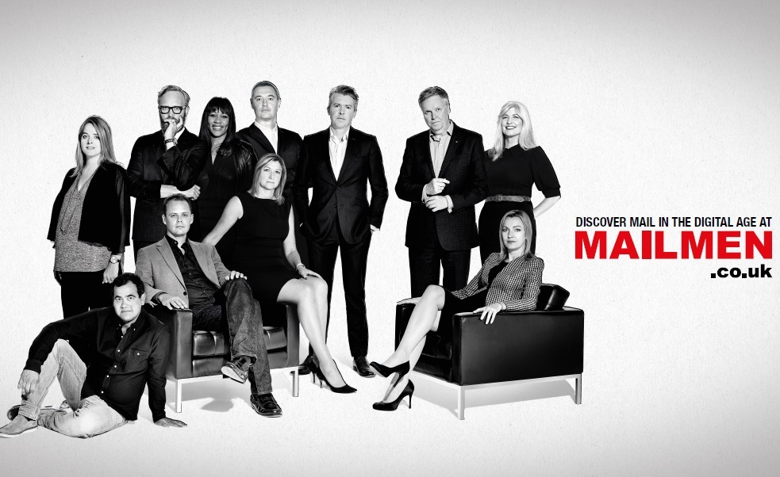

Slide 23
EXTENDED VERSIONS
OVERVIEW
FLEDGLINGS
SHARERS
COUPLES
YOUNG FAMILIES
OLDER FAMILIES
EMPTY NESTERS
OLDER RETIRED
23

Slide 24
OVERVIEW

Slide 25
PREVIOUS RESEARCH SUGGESTED
MINOR DIFFERENCES BETWEEN AGE GROUPS
Word associations with mail are very similar
Q. ‘Please choose the words you most associate with the different ways that [industry sector] tend to communicate with you [by mail]’
Base: 18-34 790; 35-54 1,059; 55+ 519. Source: Royal Mail MarketReach, Mail and Digital Part 2, Quadrangle 2014
Notes:
For example, this chart shows the results from a survey we did in late 2013 for the publication ‘It’s all about Mail and Email’. We asked respondents what words they would associate most with different types of communication, including mail.
For this current report we looked again at the data for this with specific focus on the different age groups of respondents.
As the chart above shows, the 3 different groups – 18-34, 35-54, and 55+ - had almost identical associations; so much so that it is hard to see distinctions between the red, blue, and gold lines above!
So for all ages, mail is likely to be seen as Formal, Believable, Informative, etc., and similarly is not seen as fun or spontaneous etc. There are some differences – people 35-54 are slightly more likely than the other groups to see mail as serious, important, and smart, for example – but the differences were relatively minor and didn’t hint at a trend from younger to older or vice versa.
Not surprisingly, we didn’t highlight these distinctions between the age groups in our final publication.

Slide 26
SIMILAR RESPONSE, SIMILAR PERCEPTIONS,
PERHAPS INDICATIONS OF A TREND?
Proportion taking action in response to post over the last 6 months
Statements that apply when brands, businesses or organisations use mail
I am likely to take it seriously
Source: Royal Mail MarketReach, Mail and Digital Part 1, Quadrangle 2014
It’s a professional way to communicate
“I prefer to read on paper than on screen” (% agree)
Mail statements that apply
I look forward to finding out what’s in today’s post
If I didn’t get mail any more, I wouldn’t miss it
Source: Royal Mail MarketReach, Ethnographic Quant Research, Trinity McQueen 2014
Source: Royal Mail MarketReach, Mail and Digital Part 2, Quadrangle 2014
Notes:
In fact in all of our recent work we found a similar situation across a wide range of mail behaviour and perceptions dimensions.
As you can see, the results in all of these areas show a lot of similarity.
Claimed response over the last 6 months was very similar, and responses to ‘it’s a professional way to communicate’ and ‘If I didn’t get any mail any more I would miss it’ are very close too.
Even where we saw larger differences in the response – to ‘I prefer to read on paper rather than screen’, for example – we didn’t see a trend that indicated an absolute linear relationship to age, though there was a hint of a trend - but the younger group was out of line. Was there something in this?

Slide 27
But there were unexplained variances
Why the dip in response between 25 and 44?
Bought or ordered something as a result of receiving an item of mail
Source: TGI, TouchPoints, 2015
Notes:
We opted to look at smaller age bands in the particular issue of response. To do so we used TGI data to drill down into 10 year age segments.
Again we noticed that while there did seem to be some elements of an age related trend – in this case in response – there also seemed to be some variance, especially amongst the younger groups.
So grouping consumers by age seemed to lead to more questions than answers
This and other anomalies persuaded us that age had a role to play in creating different responses, but there was more to it. We needed to look further

Slide 28
FLEDGLINGS

Slide 29
FLEDGLINGS: KEY OBSERVATIONS
Mail is novel
Limited experience, responsibility, familiarity, expectations
Mail has brand resonance
Trusted, welcome
Mail has functionality
Information and vouchers
Mail engages and stimulates
It is not digital
Mail with relevant design value is appreciated
Reflects on brand – and on them
Notes:
Mail is novel
Fledglings assume mail coming to their house is for their parent(s). They don’t get much, and usually it’s just a bank statement, as they aren’t on as many customer lists. Their lack of familiarity means that mail for them really can be rewarding – but they need ‘help’ in realising it is for them, and even in understanding what to do with it.
Mail has brand resonance
As they are looking for social signals, how a brand represents itself in post is noticed. Does it feel right for them? Is this a brand I might consider either now or in the future? Moreover, mail as a channel has more gravitas than email or other messages.
Mail has functionality
Fledglings are usually on limited incomes, so even if they aren’t paying rent, utilities, etc., they appreciate material that can help them save money like vouchers. And they are learning about new products and services, so clear information regarding the opportunities and challenges they have is much appreciated. And in that much of their mail may be transactional, they appreciate the ability to refer to a mail item when responding by whatever channel they choose. Interestingly, they can use mail to share not only within the household, but with others: sharing is not limited to online activity.
Mail engages and stimulates
Because so much of their communication is digital, mail engages them: its new and different as well as having tactility. They are looking at the format, creative idea and core proposition harder because they don’t have the familiarity of older people
Mail with relevant design value is appreciated
As noted, they are themselves ‘design oriented’ – just as they dress to impress, they respond to brands that do the same; as long as the design is truly ‘for them’.

Slide 30
FLEDGLINGS: WHAT THEY HAD TO SAY
“I have started getting stuff through the post since I got a bank account and running a sports team. It actually helps to have stuff to refer to so I don’t have to keep looking at my phone and using data.”
“I know my Nan likes a specific brand... If that’s on offer I pass her the booklet and she uses my card and goes up there... And for my friends, if there are certain nail varnishes I know they like. I’ll tell them.”
“I have these items (in the house) because: we have bought products from Go Outdoors and Costco before and are on their mailing list …I like Costco because there's always something interesting in there or deals”
Notes:
Mail is novel
Fledglings assume mail coming to their house is for their parent(s). They don’t get much, and usually it’s just a bank statement, as they aren’t on as many customer lists. Their lack of familiarity means that mail for them really can be rewarding – but they need ‘help’ in realising it is for them, and even in understanding what to do with it.
Mail has brand resonance
As they are looking for social signals, how a brand represents itself in post is noticed. Does it feel right for them? Is this a brand I might consider either now or in the future? Moreover, mail as a channel has more gravitas than email or other messages.
Mail has functionality
Fledglings are usually on limited incomes, so even if they aren’t paying rent, utilities, etc., they appreciate material that can help them save money like vouchers. And they are learning about new products and services, so clear information regarding the opportunities and challenges they have is much appreciated. And in that much of their mail may be transactional, they appreciate the ability to refer to a mail item when responding by whatever channel they choose. Interestingly, they can use mail to share not only within the household, but with others: sharing is not limited to online activity.
Mail engages and stimulates
Because so much of their communication is digital, mail engages them: its new and different as well as having tactility. They are looking at the format, creative idea and core proposition harder because they don’t have the familiarity of older people
Mail with relevant design value is appreciated
As noted, they are themselves ‘design oriented’ – just as they dress to impress, they respond to brands that do the same; as long as the design is truly ‘for them’.

Slide 31
FLEDGLINGS: TIPS
Make it clear that this item is for them not their parents
Personalisation, style, tone
Make it clear what to do next and how
Like a good UX design, guide them without being patronising
Make it share worthy
Design, tone and style should make them want to share
Make it easy to respond to by all channels
Digital and smartphone, but also by voice
Leverage tangibility
Relevant content and imagery to savour or share

Slide 32
sharers

Slide 33
SHARERS: KEY OBSERVATIONS
Addressed mail limited but welcomed if relevant
Brand and style important
Value is very important
Vouchers welcomed if found
Door drops heavily used
Discounts, local services
Communality creates sharing ‘by default’
Hallway, table, fridge
Mail starts to move out
Smartphones/work computers takes mail out of the home
Notes:
Addressed mail limited but welcomed if relevant
As noted, many sharers don’t have lots of existing relationships with companies, and they can be in relatively short term accommodation – so they don’t seem to get much addressed mail. Having said that, they do appreciate mail from their chosen suppliers that reinforces the style and brand values that made them choose the brand in the first place. The problem is that they aren’t necessarily looking for it – so it needs to impact fully communicate ‘This is for you!’
Value is very important
As mentioned, this audience often is living on a budget, and vouchers are much appreciated.
Door drops heavily used
This group is the heaviest users of door drops. This may be because they get less mail, but it also reflects the values localised door drops have in highlighting community issues – and this can support the social focus these groups have.
Communality creates sharing ‘by default’
Mail that is relevant may be shared and displayed in the accommodation, or even jointly acted upon: again, it helps if the communication is not only relevant for sharing, but also helps define/support the social positioning of the recipient.
Mail starts to move out
Digital response channels are changing the location where mail is dealt with. Because people can respond by mobile or often by computer at work, mail is moving out of the home.

Slide 34
SHARERS: WHAT THEY HAD TO SAY
“I do like getting the Chelsea magazine. It’s glossy and does have some interesting articles in it. It’s quite substantial. So I tend to keep it around the living room for a week or two.”
“My letter and newsletter from Plan charity came three weeks ago. I didn't open for a week as was too busy. Then it was in my work bag for a few days then I opened it on the train the next day. and then have kept it in my bedroom by the side of the bed.”
“They [The Hershel Supply Company] sent a really nice glossy visuals catalogue that I kept since I liked the photography and ethos of the company... it was nice to see a company take so much care and attention to detail in promoting their brand.”
Notes:
Addressed mail limited but welcomed if relevant
As noted, many sharers don’t have lots of existing relationships with companies, and they can be in relatively short term accommodation – so they don’t seem to get much addressed mail. Having said that, they do appreciate mail from their chosen suppliers that reinforces the style and brand values that made them choose the brand in the first place. The problem is that they aren’t necessarily looking for it – so for impact it needs to fully communicate ‘This is for you!’
Value is very important
As mentioned, this audience often is living on a budget, and vouchers are much appreciated.
Door drops heavily used
This group is the heaviest users of door drops. This may be because they get less mail, but it also reflects the values localised door drops have in highlighting community issues – and this can support the social focus these groups have.
Communality creates sharing ‘by default’
Mail that is relevant may be shared and displayed in the accommodation, or even jointly acted upon: again, it helps if the communication is not only relevant for sharing, but also helps define/support the social positioning of the recipient.
Mail starts to move out
Digital response channels are changing the location where mail is dealt with. Because people can respond by mobile or often by computer at work, mail is moving out of the home.

Slide 35
SHARERS: TIPS
Create personalisation that stands out on the doormat
For them not for someone else
Reflect the life they want to live
Social status, sociability, stylish, open to new experiences
Build brand equity for the future
Value is a powerful message for them
Be clear and upfront
Design for mobility
Make it easy to use on the go
Consider door drops
Shared accommodation areas can be targeted

Slide 36
couples

Slide 37
COUPLES: KEY OBSERVATIONS
Highly diverse group
From new relationships to long term partnerships
Maintain social orientation
Eating out, clothes, trendy places to eat
Beginning to take mail more seriously
More responsibility for managing commercial and public sector relationships
Very close to the norms in most mail matters
Response, filing, researching, etc.

Slide 38
COUPLES: WHAT THEY HAD TO SAY
“If something sparkly and new catches my eye, I’m automatically drawn to it regardless of whether it is a TV ad, an ad on Facebook or something through the post.”
“We live in an apartment, we don’t want clutter everywhere, so it’s pretty much ‘sort then it’s gone straightaway’... There’s no ‘I’ll come back to that later - you either grab my attention or you don’t."
“I received a booklet from estate agents; a property magazine, and I actually bought my house from the info that was advertised within it – off plan – and I got quite a good deal.”

Slide 39
COUPLES: TIPS
Partner and friends focused but building slightly more grown-up lives
Make mail stylish, fun but also look important to the lives they want to build
Recognise mail is starting to have a place in their ‘home’
They have partners and homes so begin to share ‘important’ mail
Unaddressed mail helps them engage with local area
Be single minded about what you want them to do
Be overt about value on both envelope and content
Be specific and clear about what they should do and how they do it
Emphasise digital response channels
Door drops have an important role to play for local amenities
Including local offices of national chains

Slide 40
Young families

Slide 41
YOUNG FAMILIES: KEY OBSERVATIONS
New life creates new needs and enthusiasm
Highly receptive to relevant mail for new information, products and relationships
New responsibilities include engaging with mail more actively
Read, share, display, respond, enquire, visit, try, provide etc.
Digital becomes key response channel
Both PC and smartphone
Price consciousness rises
Use of vouchers
Time poverty creates appreciation of a few quiet moments to savour
Magazines, catalogues

Slide 42
YOUNG FAMILIES: WHAT THEY HAD TO SAY
“These were sent to me by Boots in an envelope referring to my daughter’s upcoming 1st birthday so I decided to open it. It contained a voucher for a free photo book which I have been on to the Boots website and used to order the book. I have kept the items below because I think they will be very useful as they contain information regarding child nutrition and food ideas for my one year old.”
“I get some nice ideas for things from it, [Laura Ashley brochure] things I might want to buy, or curtains I might get made... It gives me some inspiration.”
“It’s [Lakeland catalogue] an association. It means a cup of tea and 10 minutes for me. Flicking through something that’s pretty to look at.”

Slide 43
YOUNG FAMILIES: TIPS
Mail is a valued medium in its own right
Content rather than style drives engagement
Time is precious
Make value clear and up front
Make call to action simple and clear
Make digital the key response channel
Appeal to them in their family roles
Show you empathise with their role as parents
Help them find the best choices for their families
Reflect their energy or their need to relax
They will take time with emotionally rewarding material

Slide 44
Older families

Slide 45
OLDER FAMILIES: KEY OBSERVATIONS
Mail is fully integrated and used
Above average in almost all actions taken
More mail is received than for previous groups, and received positively
Including but not limited to loyalty and value communications
Display and sharing are particularly important
Family input, family roles
Digital remains key response channel
At home, on commute, at work

Slide 46
OLDER FAMILIES: WHAT THEY HAD TO SAY
“My wife deals with all of the finance – well, she's a book-keeper. But she leaves very early and I often work at home. So I tend to work out what needs action and it all goes here on her laptop. She’ll deal with everything usually at least once a week – all of that’s done online where we can.”
“Go Outdoors is a really good shop. Kids are into camping and Scouts... (re the catalogue) I tend to have a flick through (but) it’s more about the lads. It’s handy to have something like this, you can have a flick through to see what’s there and then we’ll go online before going in (store).”
“I like the occasional new season brochure from Boden/Hush as I like their clothes... brochure is good to bookmark pages but if I buy it's almost always online. I like the content... nice quality clothing always photographed well.”

Slide 47
OLDER FAMILIES: TIPS
Recognise the role of the family
Mail is often shared and displayed
Consider how your design and content might work in this context
This group can be hard pressed financially
Highlight value messages
Mail is used to respond and to evaluate – and evangelise – brands
Brands used by parents are seen and noticed by children
Leverage this with relevance to sender but also inclusivity for the family
Mail informs and drives digital response and action
Keep the digital response channel - including out of home - front of mind

Slide 48
Empty nesters

Slide 49
EMPTY NESTERS: KEY OBSERVATIONS
The future is coming
Believe in ‘managing money’ to consolidate pre-retirement and/or ‘live life to the full’
Highly responsive to mail and print generally
Including newspapers
Dealing with mail is organised and highly selective
Discard quickly if irrelevant but savour or store valued material
Digital response bias replaced by phone
A generation effect?

Slide 50
EMPTY NESTERS: WHAT THEY HAD TO SAY
“A brochure from Cotton Traders a few years ago tempted me to send off by post for clothing and shoes… I have since transferred to online ordering from Cotton Traders which I do fairly regularly.”
“To look through [the brochure on] e-mail… you just couldn’t do it, you’re not going to look through 80 pages but this is divided into girls, boys, teenagers… I’d much rather look at a brochure than online but I think that’s probably because we’re older.”
“Anything that comes has got to have an interest to it… or it has to have value and it tells you what’s coming up promotion wise for the following week.”

Slide 51
EMPTY NESTERS: TIPS
Build on Empty Nesters’ comfort and respect for printed materials
Longer copy is acceptable if relevant. Overly ‘designed’ executions less so
Respect their pride in their life experience
Speak to them in a personal yet respectful manner: don’t condescend
Understand and speak clearly to their emotions regarding their future
Deliver either reassurance or inspiration
Baby Boomers are the original teenagers
They value choice and individuality: offer them a range of response channels
They are ageing, not old
Many will still have living relatives from the previous generation

Slide 52
Older retirees

Slide 53
OLDER RETIREES: KEY OBSERVATIONS
Familiar, comfortable and confident about dealing with mail
Respond, re-read, keep, respond by post
But also quick to reject irrelevant material
Heavy engagement with relevant addressed (and unaddressed) mail
Spend 21 minutes per day on mail; highest of any group
Gives them a sense of ‘control’
Relevant material is likely to be shared or saved
Relevance may be for the extended family

Slide 54
OLDER RETIREES: WHAT THEY HAD TO SAY
“I will go through all the brochures eventually and decide if there’s anything there and if there isn’t they get thrown away. There’s an item in one of the older ones I really like, a possible wedding present. I’m keeping it because they haven’t got married and I like the item – I haven’t seen them anywhere else. It’s a reminder.”
Q: “Why do you like the cruise brochure?”
“To see where they’re going... And then I did go on their web site to look into it from that. But actually having it in the catalogue, it’s easy to show anyone I want to show it to – where I’m thinking of going.”

Slide 55
OLDER RETIREES: TIPS
Build on their comfort and respect for printed materials
Longer copy works, as does sticking with traditional rules of grammar
Values - as well as good value - are important to them
Most will have static income so providing discounts will be appreciated
But mail will be even more appreciated if it resonates with their world view
Remember that many are alone – and not all by choice
For them, mail includes personal messages between friends or relatives
Create copy that – like the radio – can offer ‘company’ as well as content
Relevant mail can be saved, savoured and shared
Think beyond them and beyond immediate response – and remember their user experience can influence many others
Response is more likely to come by post
But telephone – and even digital – response is possible

Slide 56
Thank you

